Slide 1

Let em Cook!
“Make your kitchen a playground!”
A5: Lo-Fi Prototype +
Pilot Usability Testing
Mayowa A. Butch N. Esaw A. Tina Z.
Notes:
Remember your mouse as clicker

Slide 2
Outline
Notes:
here by 40 s

Slide 3
Outline
Recap
Concept Sketches
Realizations
Interface Selection
Lo-Fi Prototype
Task Flows
Usability Testing Methodology
Usability Testing Results
Discussion/Recap
Appendix
Notes:
quick overview

Slide 4
Recap:
Problem, Solution, Primary User Base

Slide 5
Problem
People aren't willing to explore and get out of their comfort zone while cooking because it is not enjoyable enough.

Slide 6
Solution
A Social Cooking App that incentivizes individuals to explore cooking by offering unique challenges, virtual rewards, and opportunities for interactions with other users

Slide 7
Primary Users
Young adults living independently for the first time, who need some extra motivation to start cooking and getting out of their zone in a safe environment.

Slide 8
Concept Sketches
More Details Included in Our Sketch Report

Slide 9
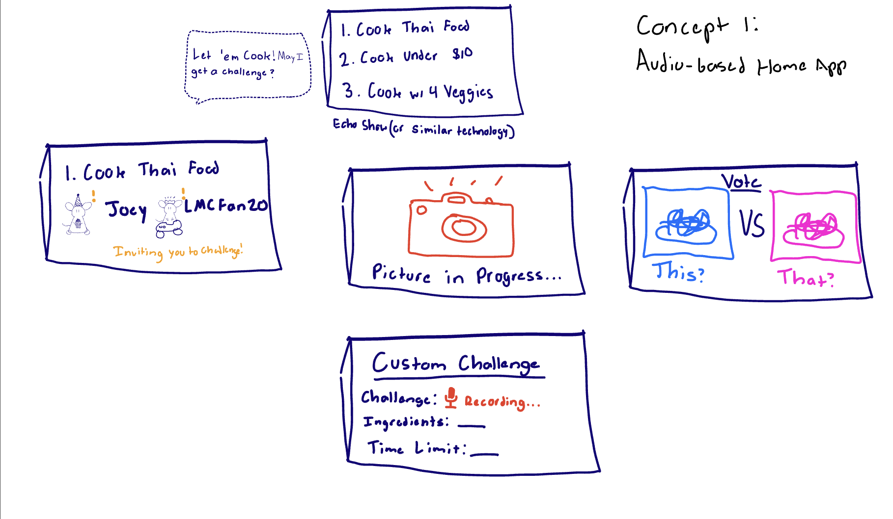
Notes:
DON'T DISCUSS TOO MUCH, JUST SHOW FOR THOUGHT PROCESS

Slide 10
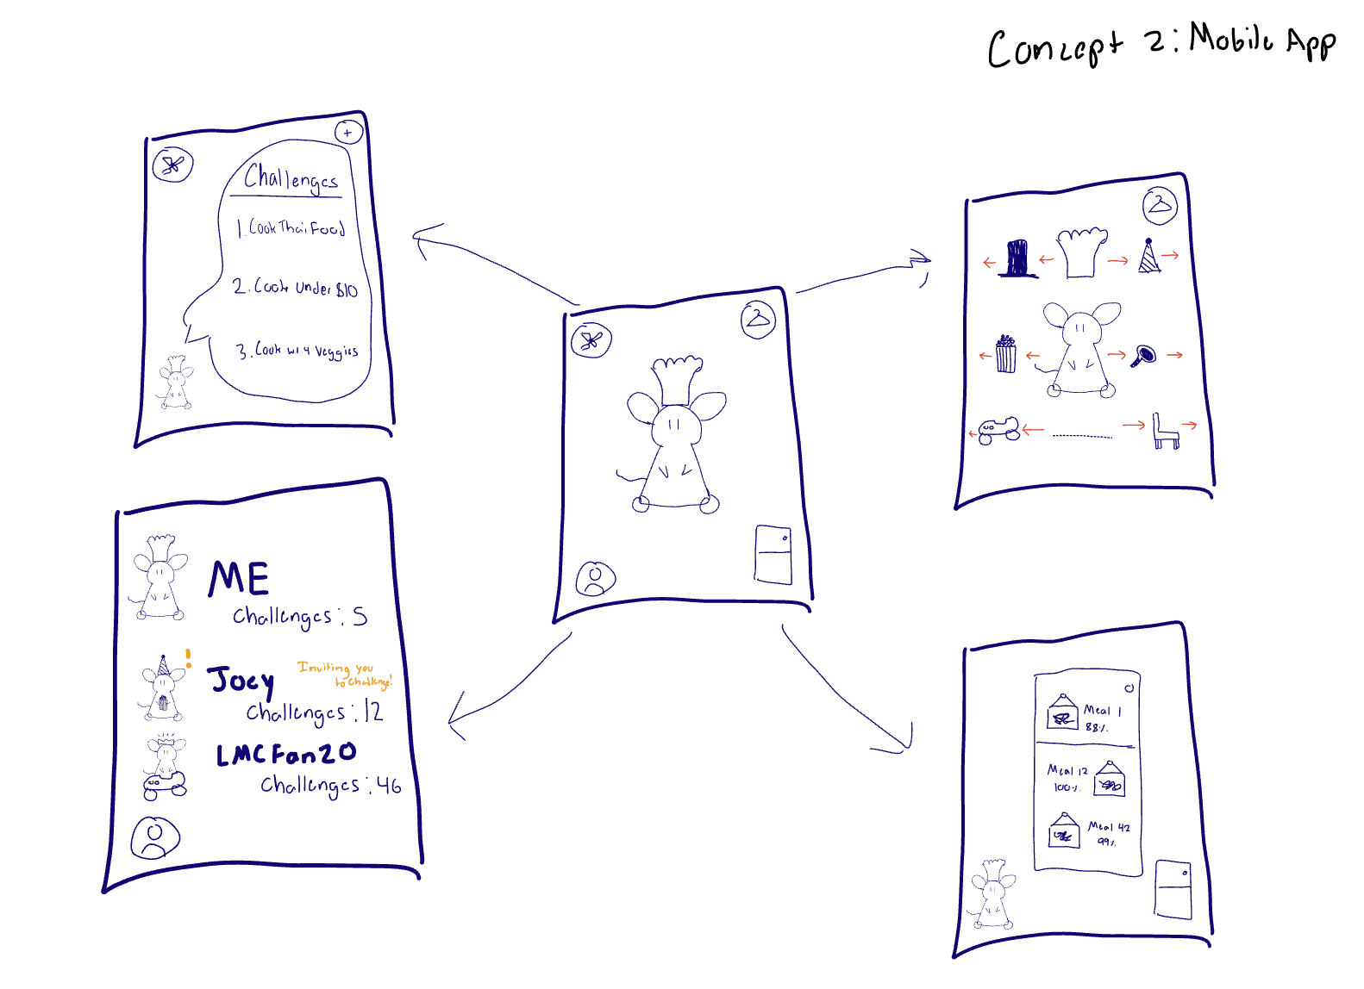
Notes:
Don't spend long on describing each screen

Slide 11
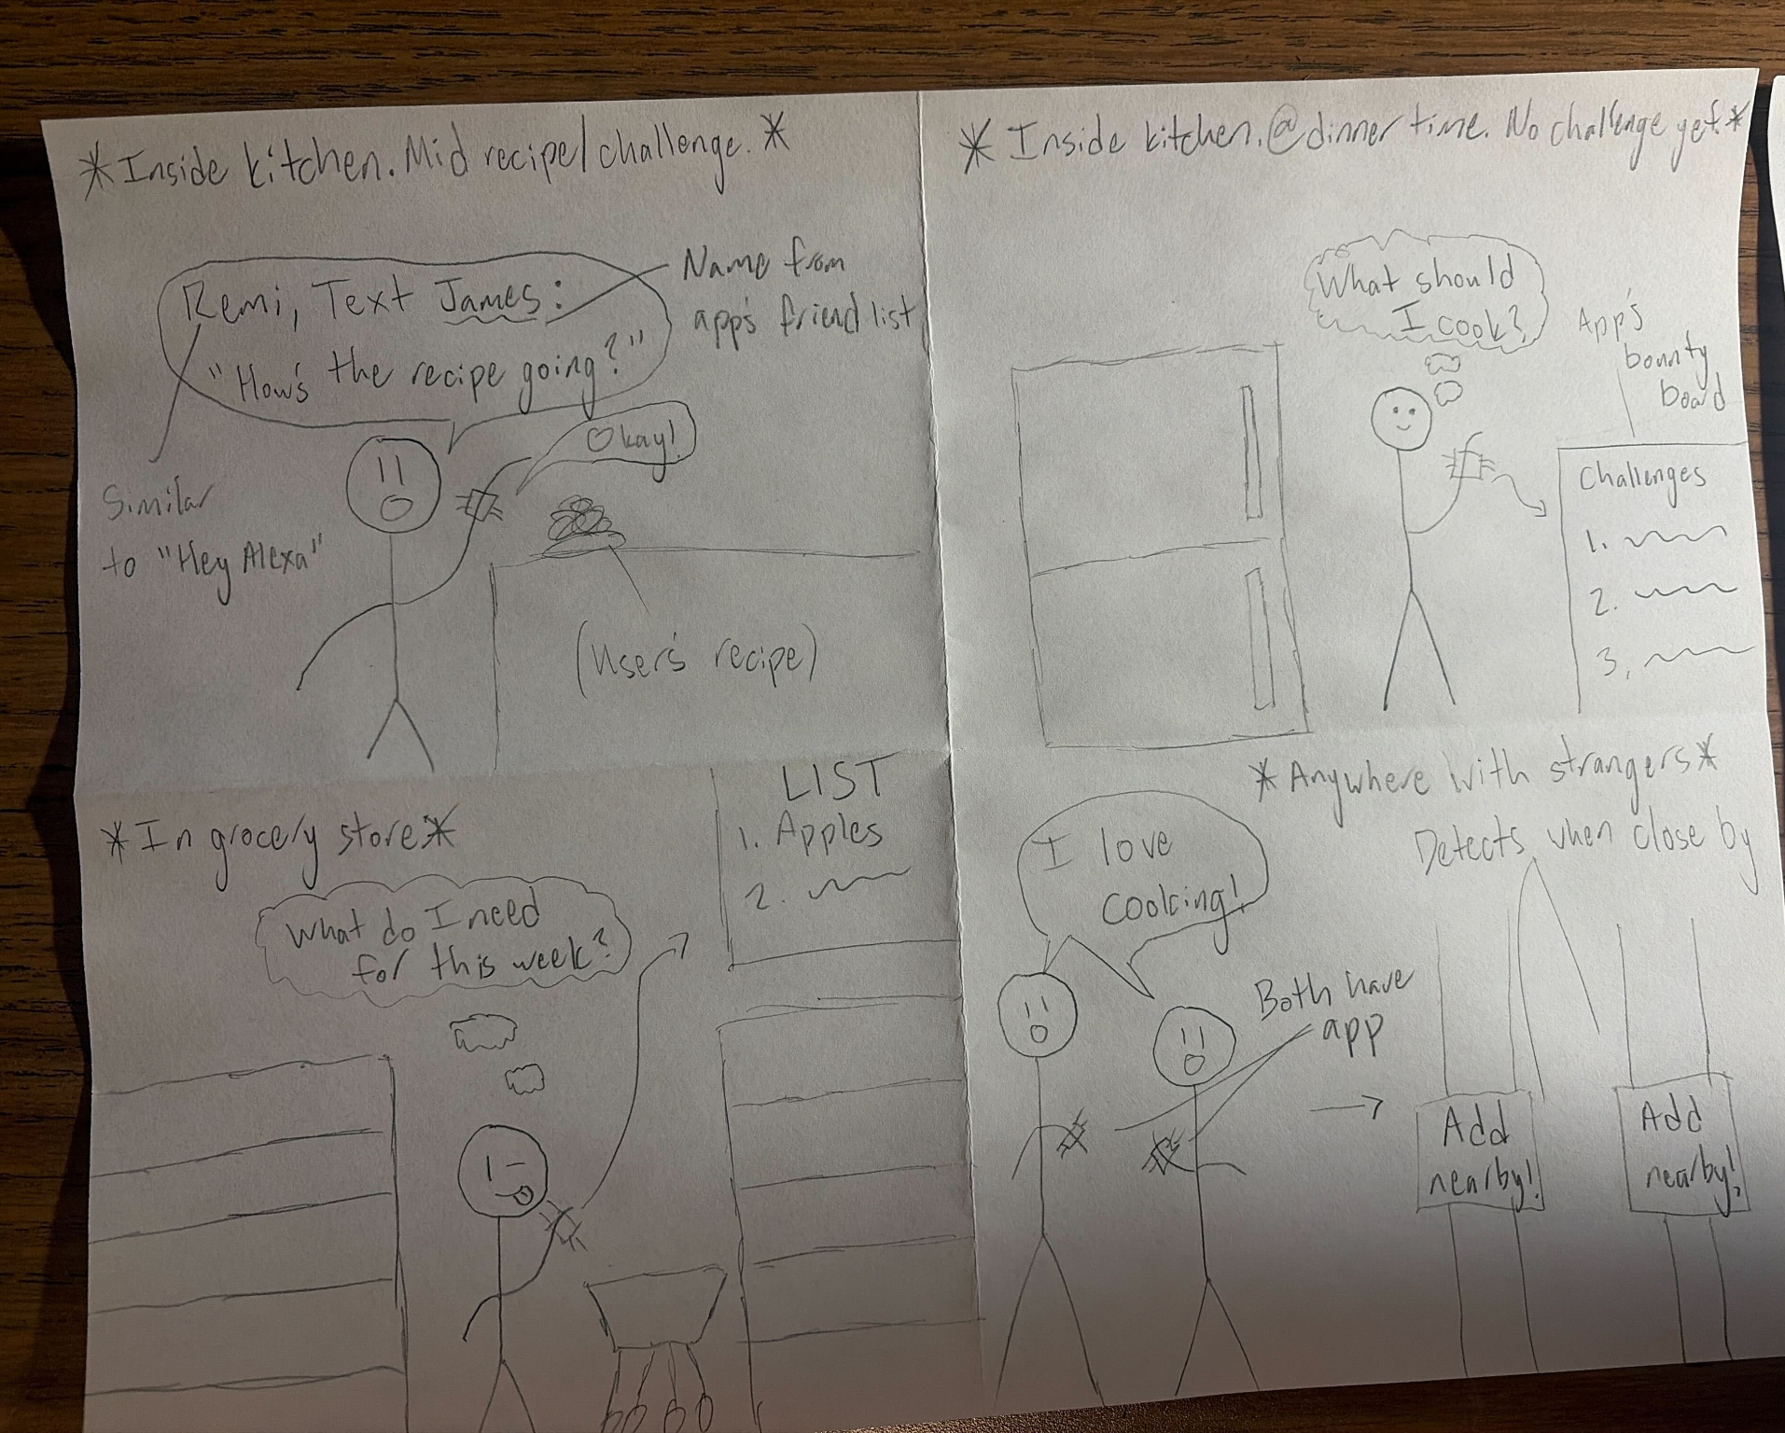
Concept 3:
Smart Watch

Slide 12
Fleshed Out Realizations
More Detail Included in our Sketch Report

Slide 13
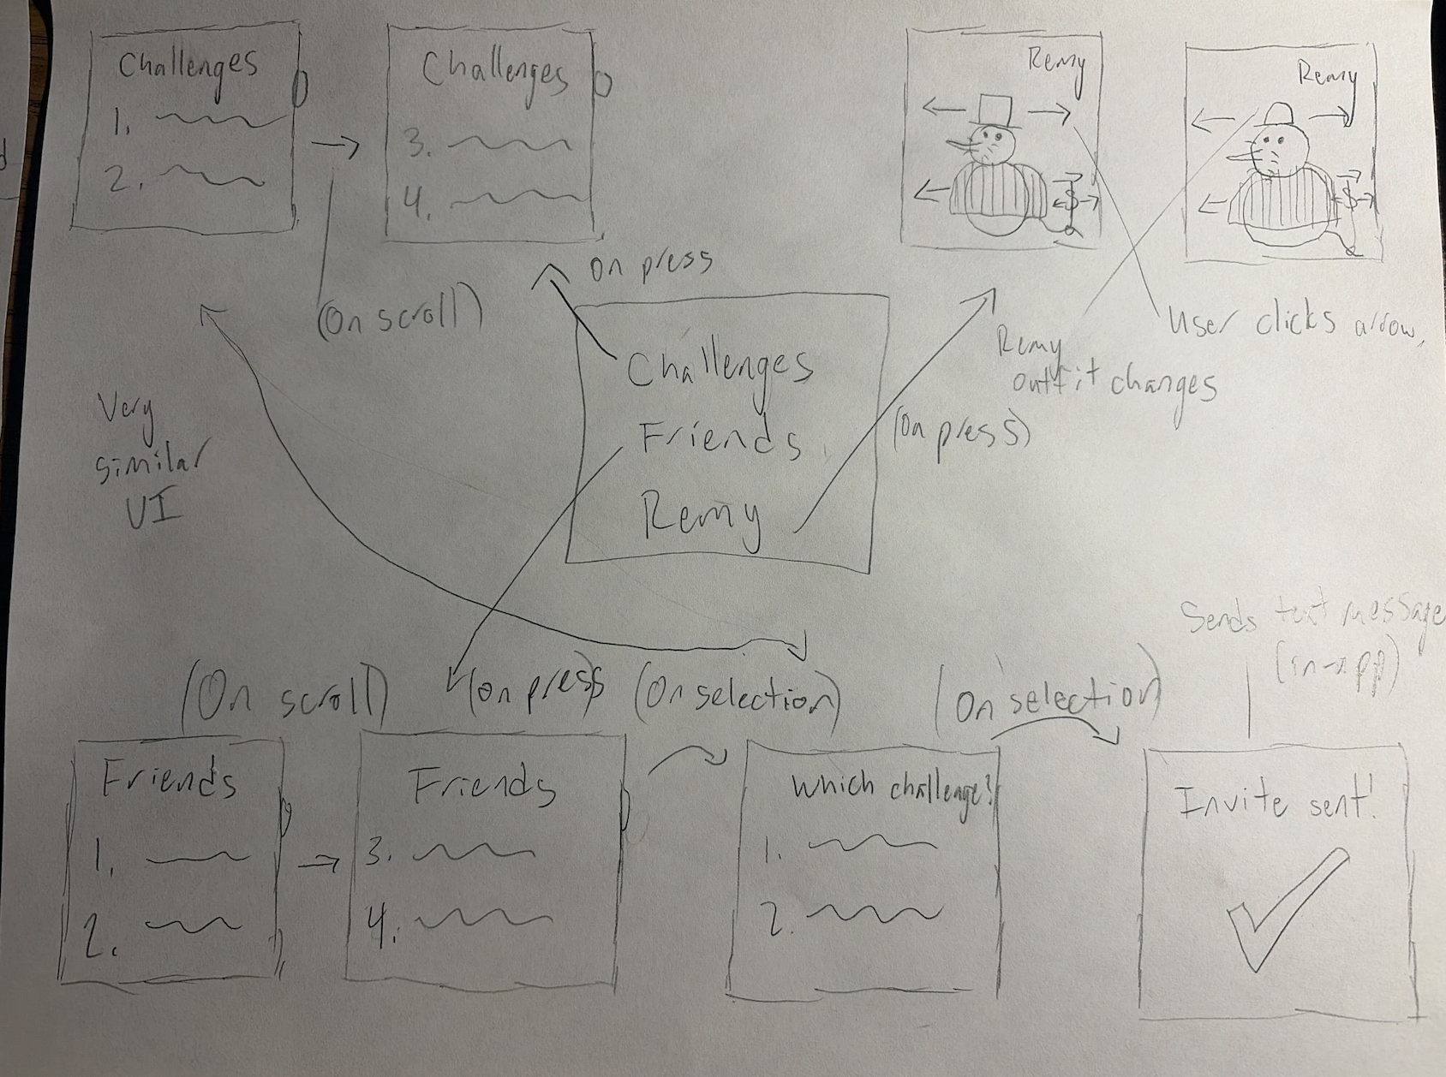
Diverse Realization 1:
Smart Watch
Notes:
Don't linger; describe scroll and each thing succinctly

Slide 14
Diverse Realization 1:
Smart Watch
Home Screen
Challenges
Pal (Remy, in this case)
Friends

Slide 15
Realization 1 - Smartwatch App
Pros:
Cons:
Requires less attention
Hands-free
Accessible at moment’s notice
Linking to Apple/Galaxy Watch Health apps
Higher barrier to entry
Lot more scrolling
Lists/texts much harder to read
Less forgiveness for “fat fingering”
Likely audio-reliant (inaccessible)
Mediocre camera feature
Pros are pretty minor. App wouldn’t be intended to be used much while cooking.
Watch apps must be very simple else difficult to use.

Slide 16
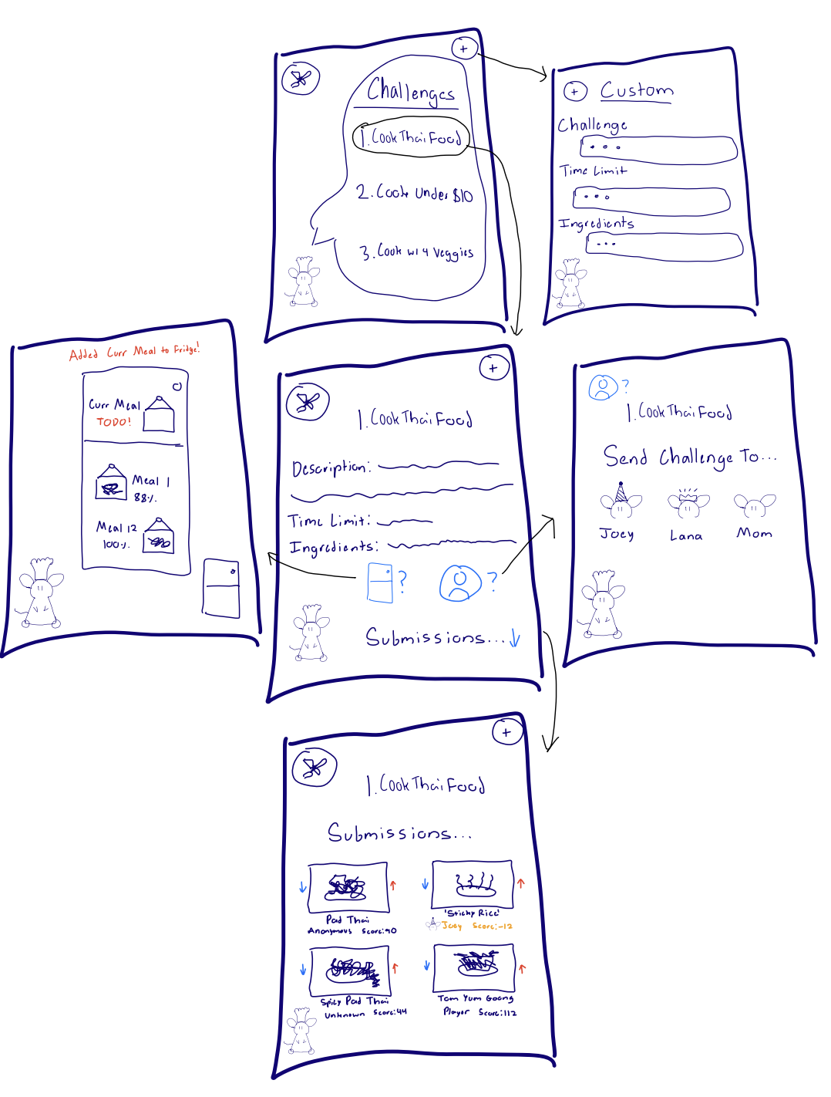
Diverse Realization 2:
Mobile App
Notes:
Don't too long on describing each screen (just overview)

Slide 17
Diverse Realization 2:
Mobile App
Challenges (Landing)
Tappable Options
Custom Challenges
(Tap into Text entry)
Send Challenge to Friend(s)
Fridge
(stores challenges,
memories,
current working challenge)
Example Challenge Page with Links
Submissions Page (Voting) - global entries

Slide 18
Realization 2 - Smartphone App
Pros:
Cons:
Lower Barrier to Entry (most individuals have smartphones)
Familiar UI/Operation Scheme (tap, scroll, etc.)
Simple cross-platform engineering
Utilize built-in camera, contact list
Large screen for images
Lots of permission-accessible utility (location, gyroscopic, voice, etc.)
Hard to use while cooking
Touch-focused (nearly exclusively)
Competes with other uses for phone (not unique relative to other apps on the device)
Platform-specific pains (Apple app store requirements)
Cons are similar to watch, but more minor. Pros include lower barrier to entry, reduced buy-in, and less complexity for designers in implementing unique features
Notes:
here by 2 mins

Slide 19
Selected Interface: Smartphone App

Slide 20
Why is Smartphone App Superior?
Smartphone
Watch
92% Americans own
Touchscreen
Motion Controls
Voice
Location
Widespread Familiarity with app interfaces/usages
Larger screen for images + text
Improved Camera Feature
~30% American own
Touchscreen
Motion Controls
Voice
Location
Reduced Familiarity with app interfaces/usages
A smartphone app has similar cons, but wider reach, more familiar to our target audience, similar and has additional affordances over the watch)

Slide 21
Lo-Fi Prototype
Physical, Paper Prototype Simulating UI Layout
Notes:
Here by 4:00

Slide 22
Lo-Fi Prototype Construction
Drawn/created digitally, then printed out in traditional paper prototype form.
(manual computer used)
New screens removed/placed on top. Actions: Tap, Scroll, Type
Features This Iteration: Challenges Tab

Slide 23
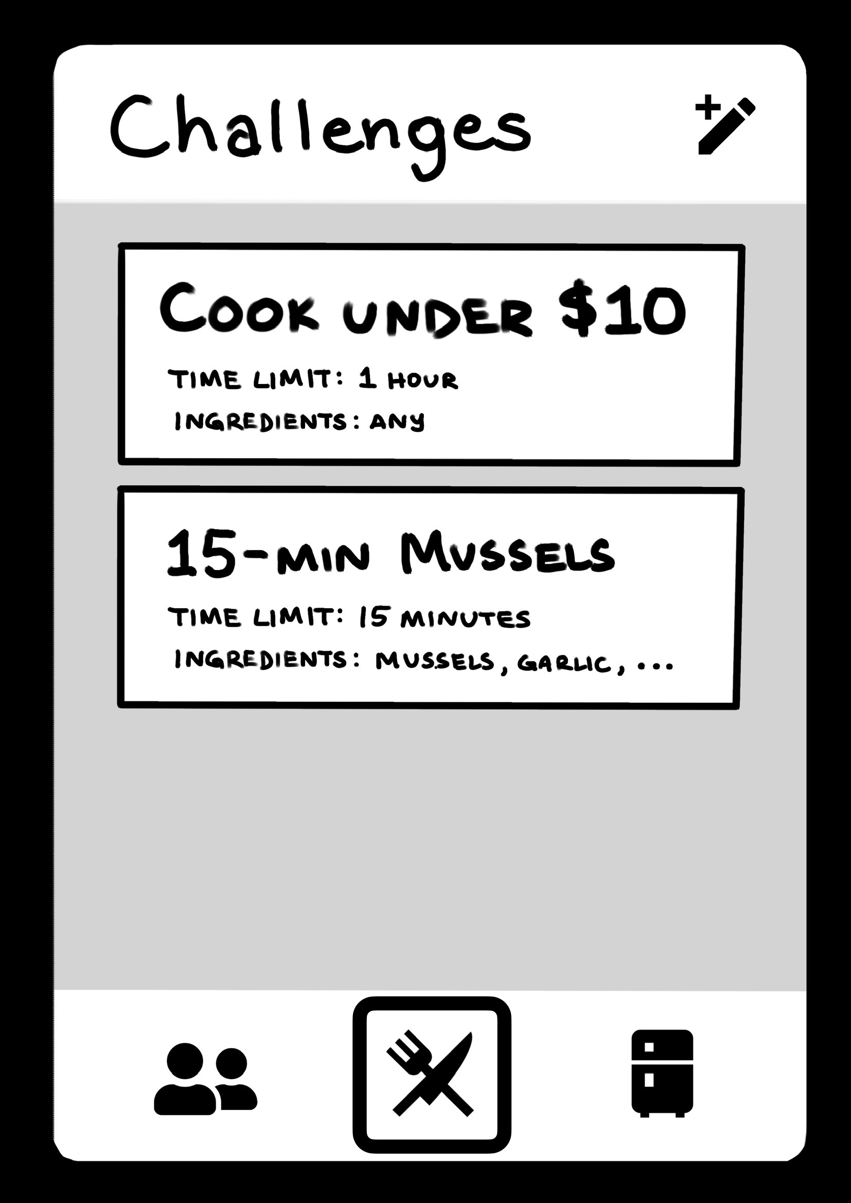
Lofi Prototype Landing Screen
Simple, Clean Layout
Minimal Tab Clutter
Tap to preview more information

Slide 24
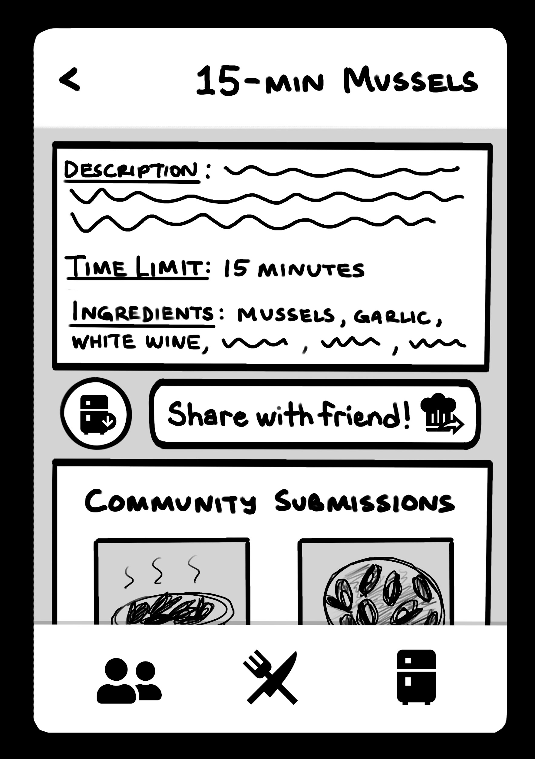
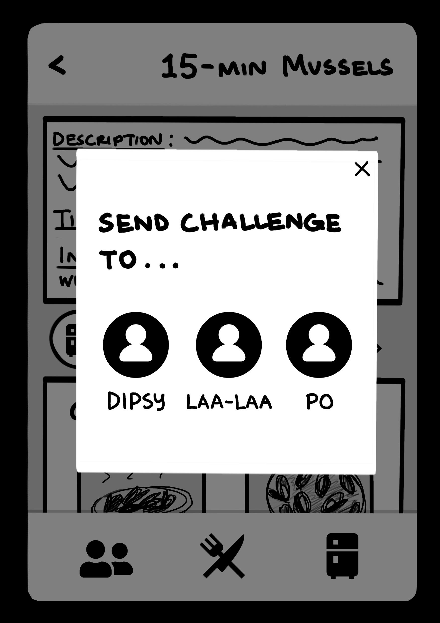
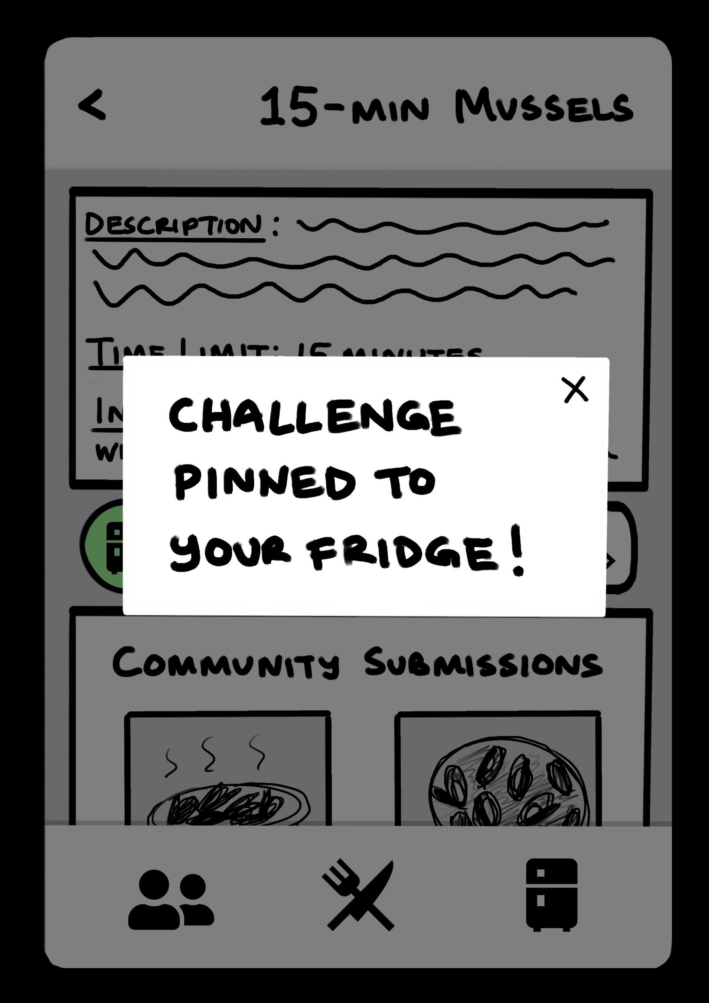
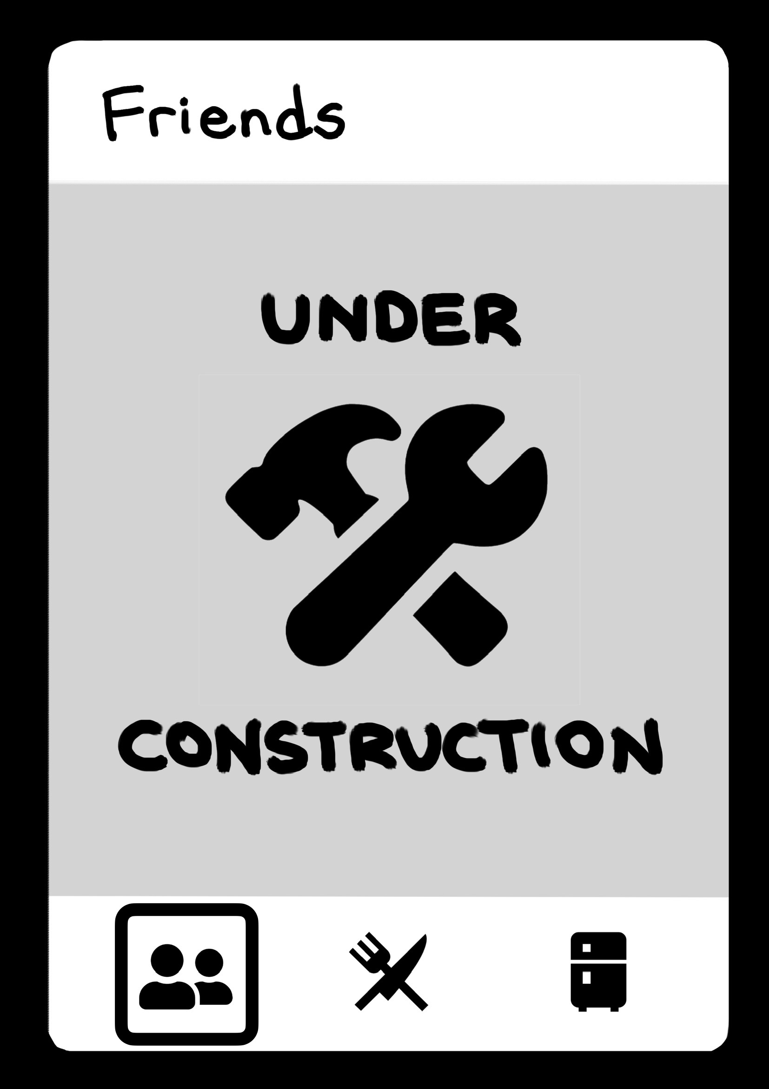
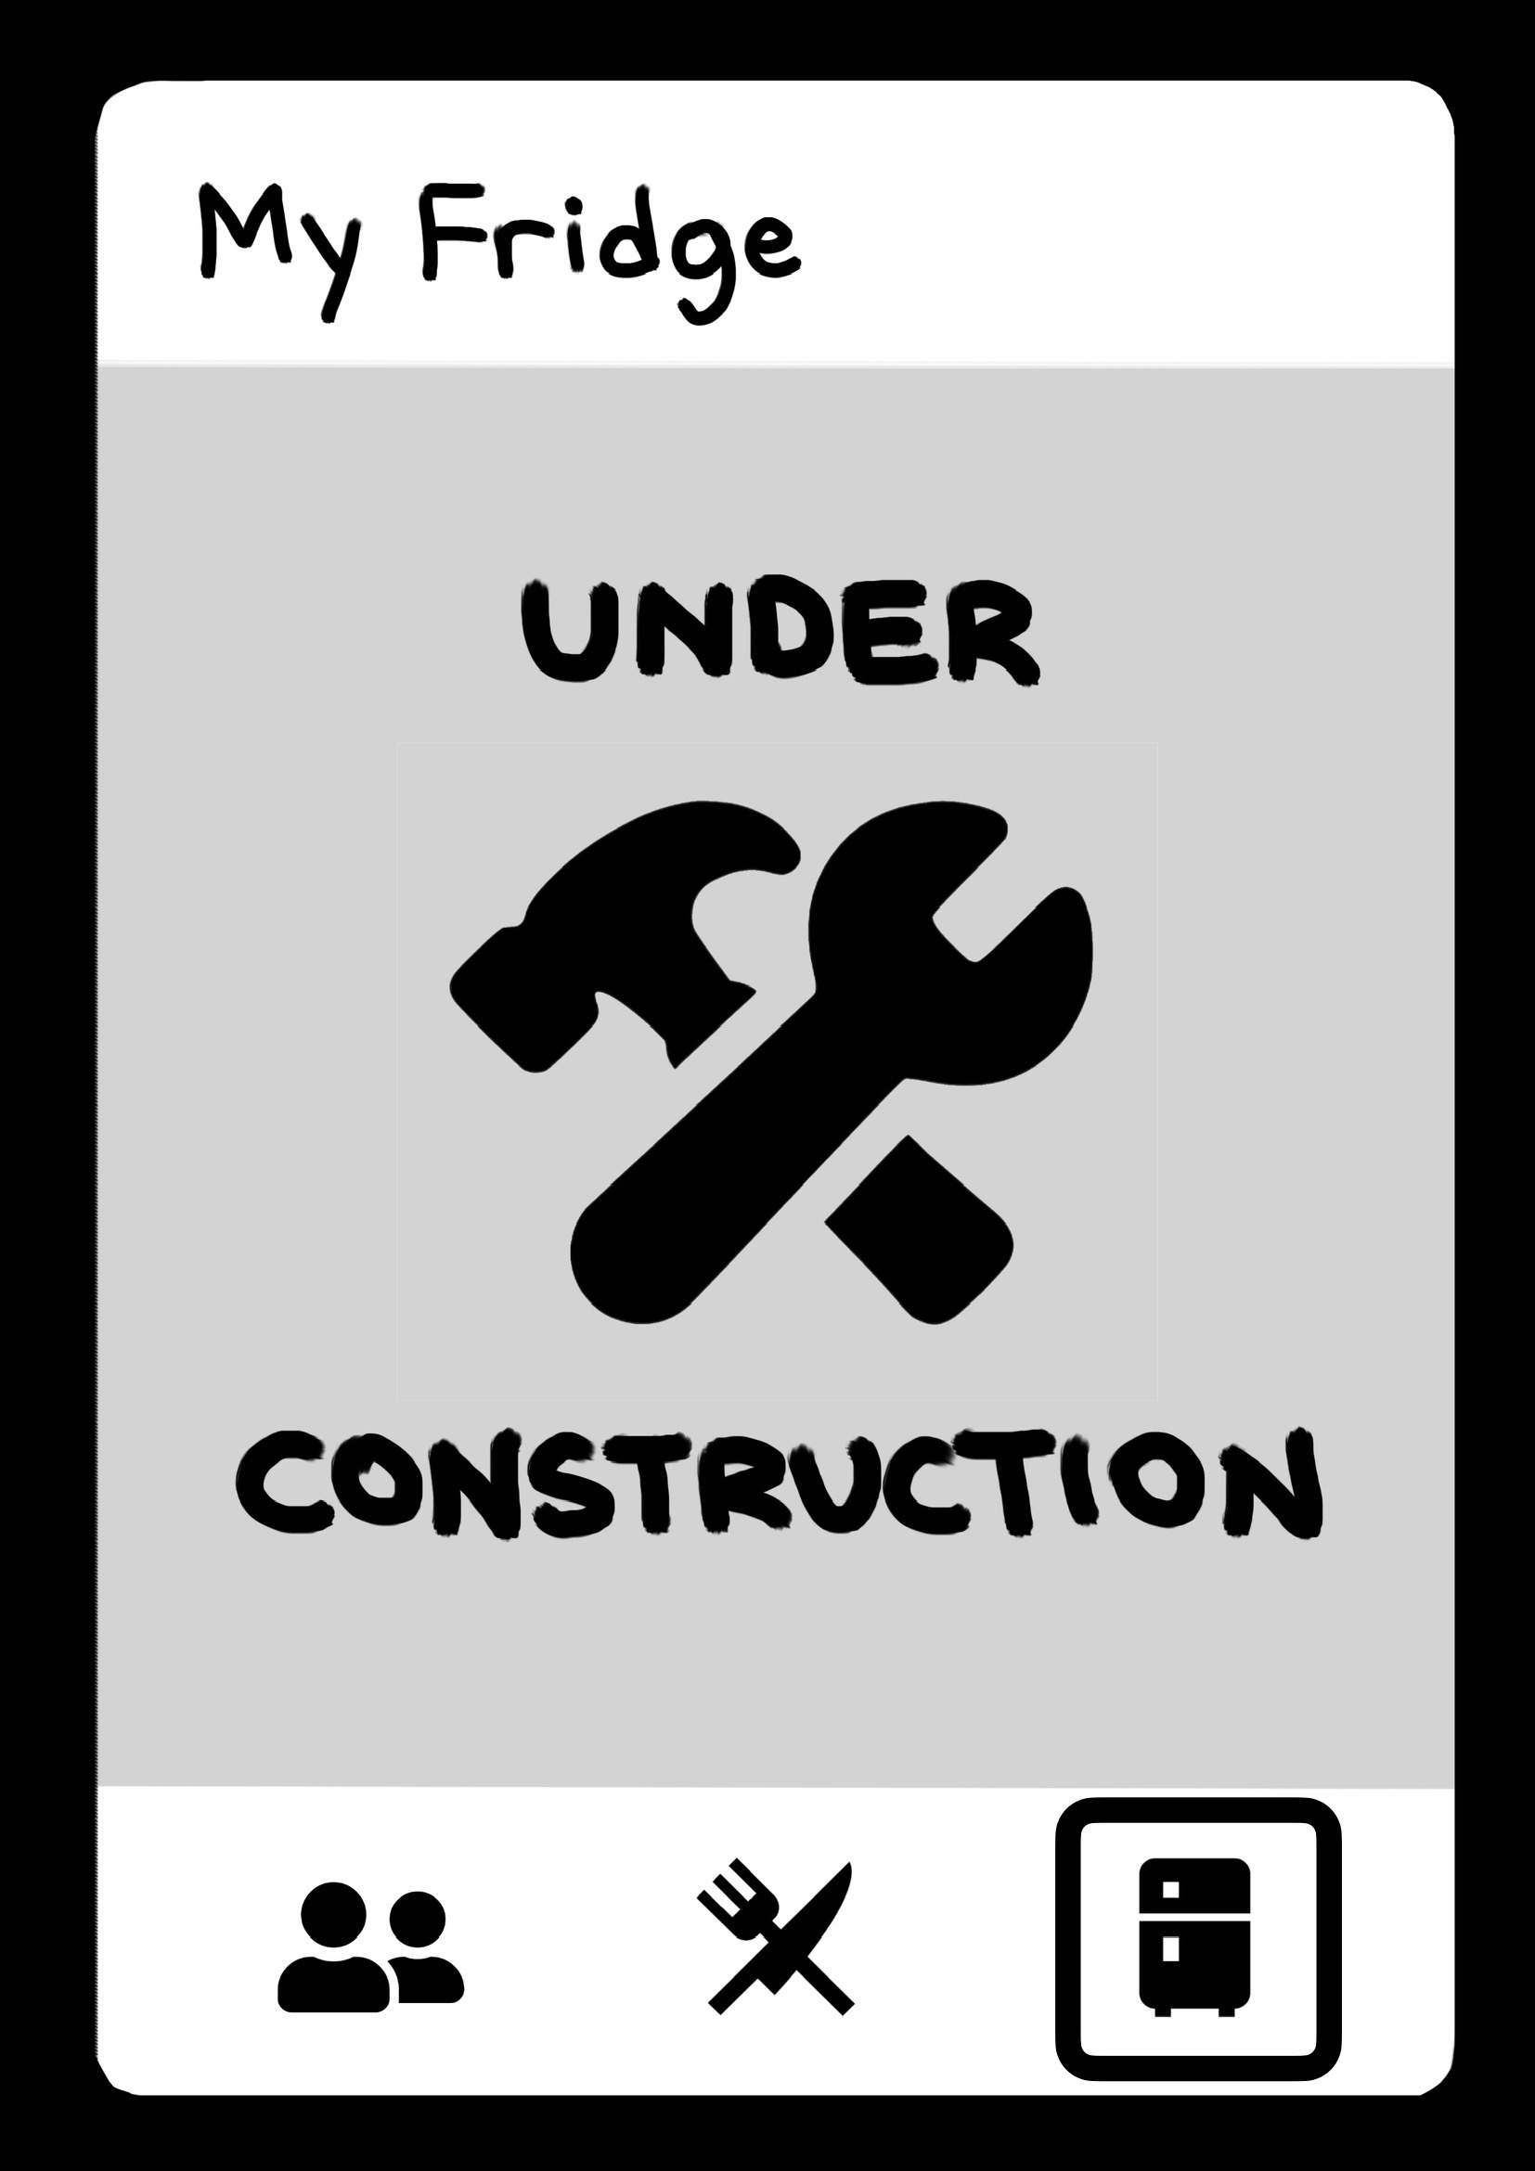
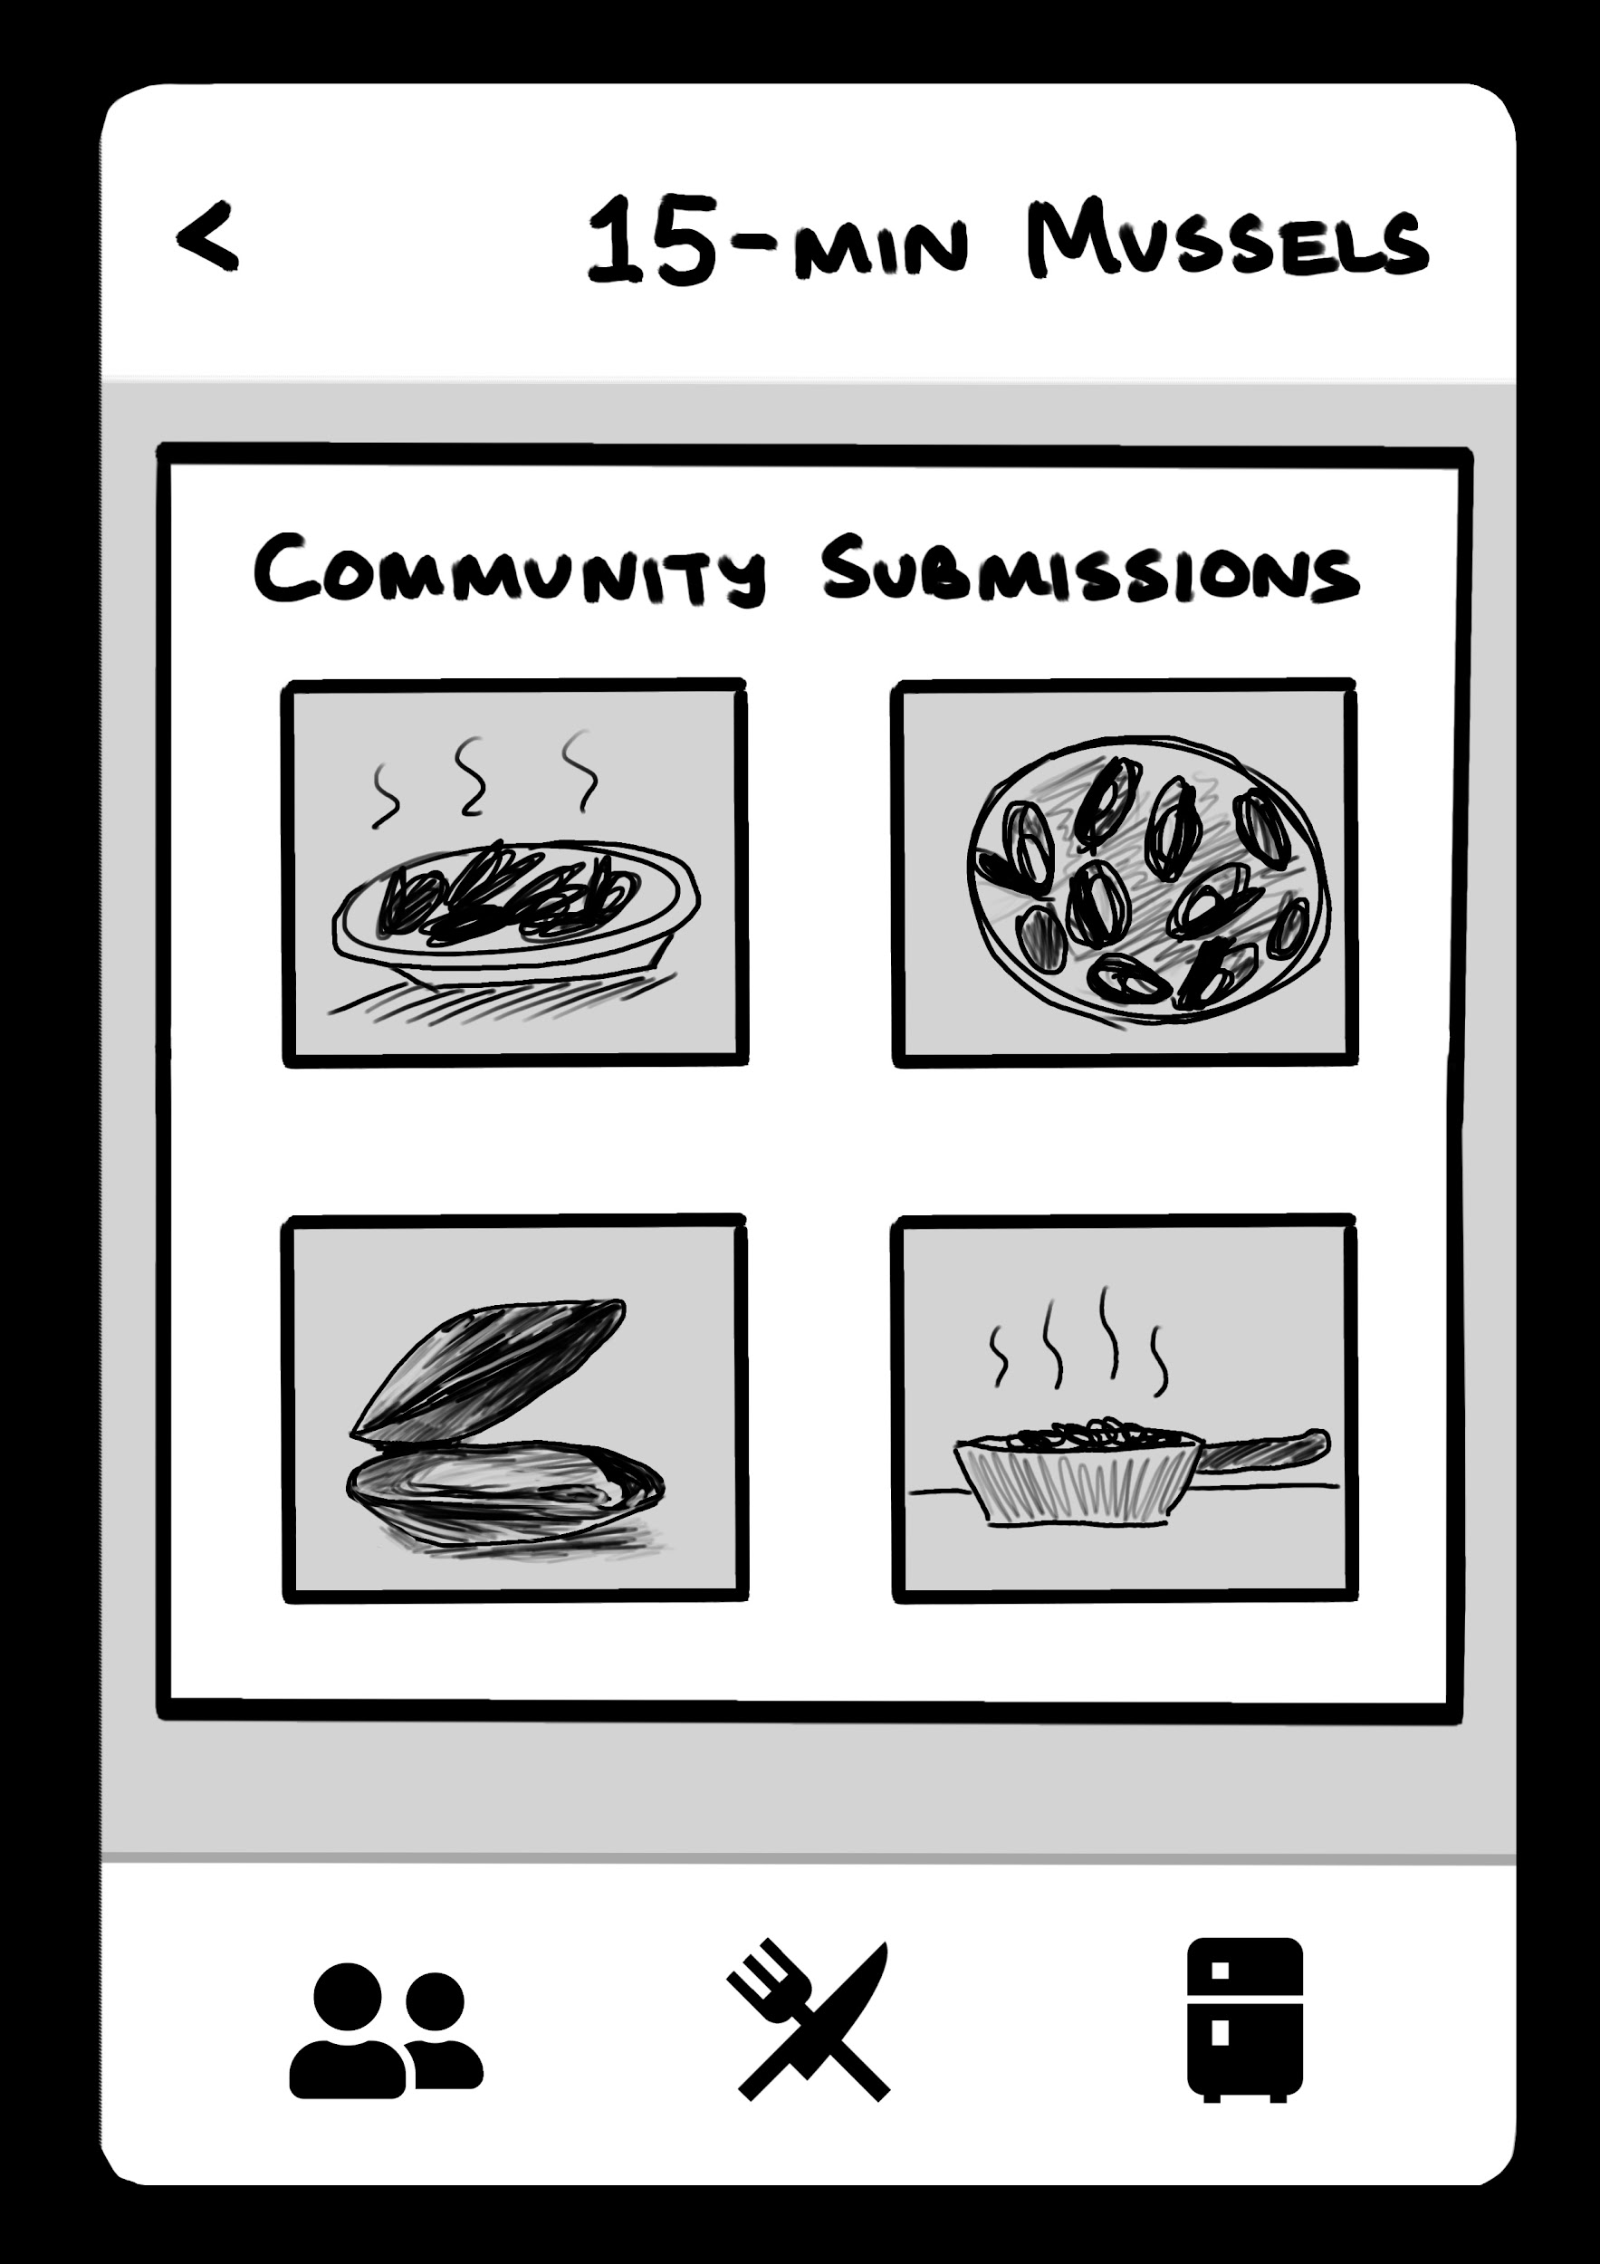
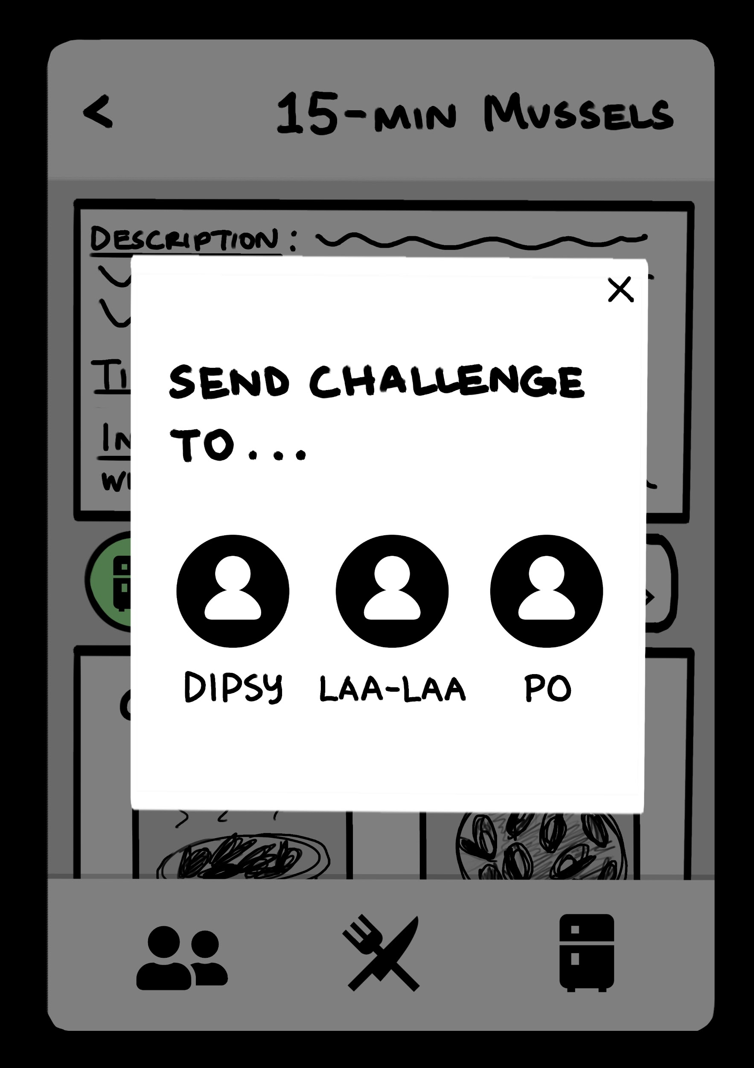
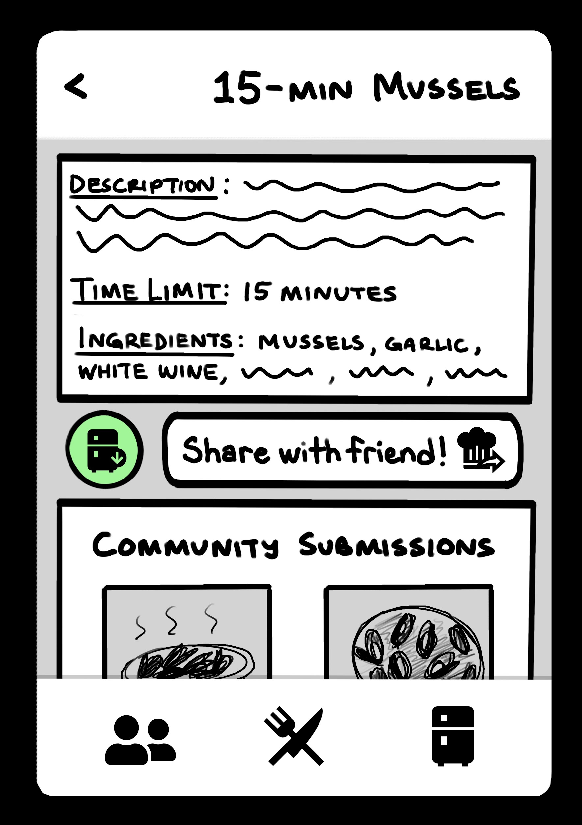
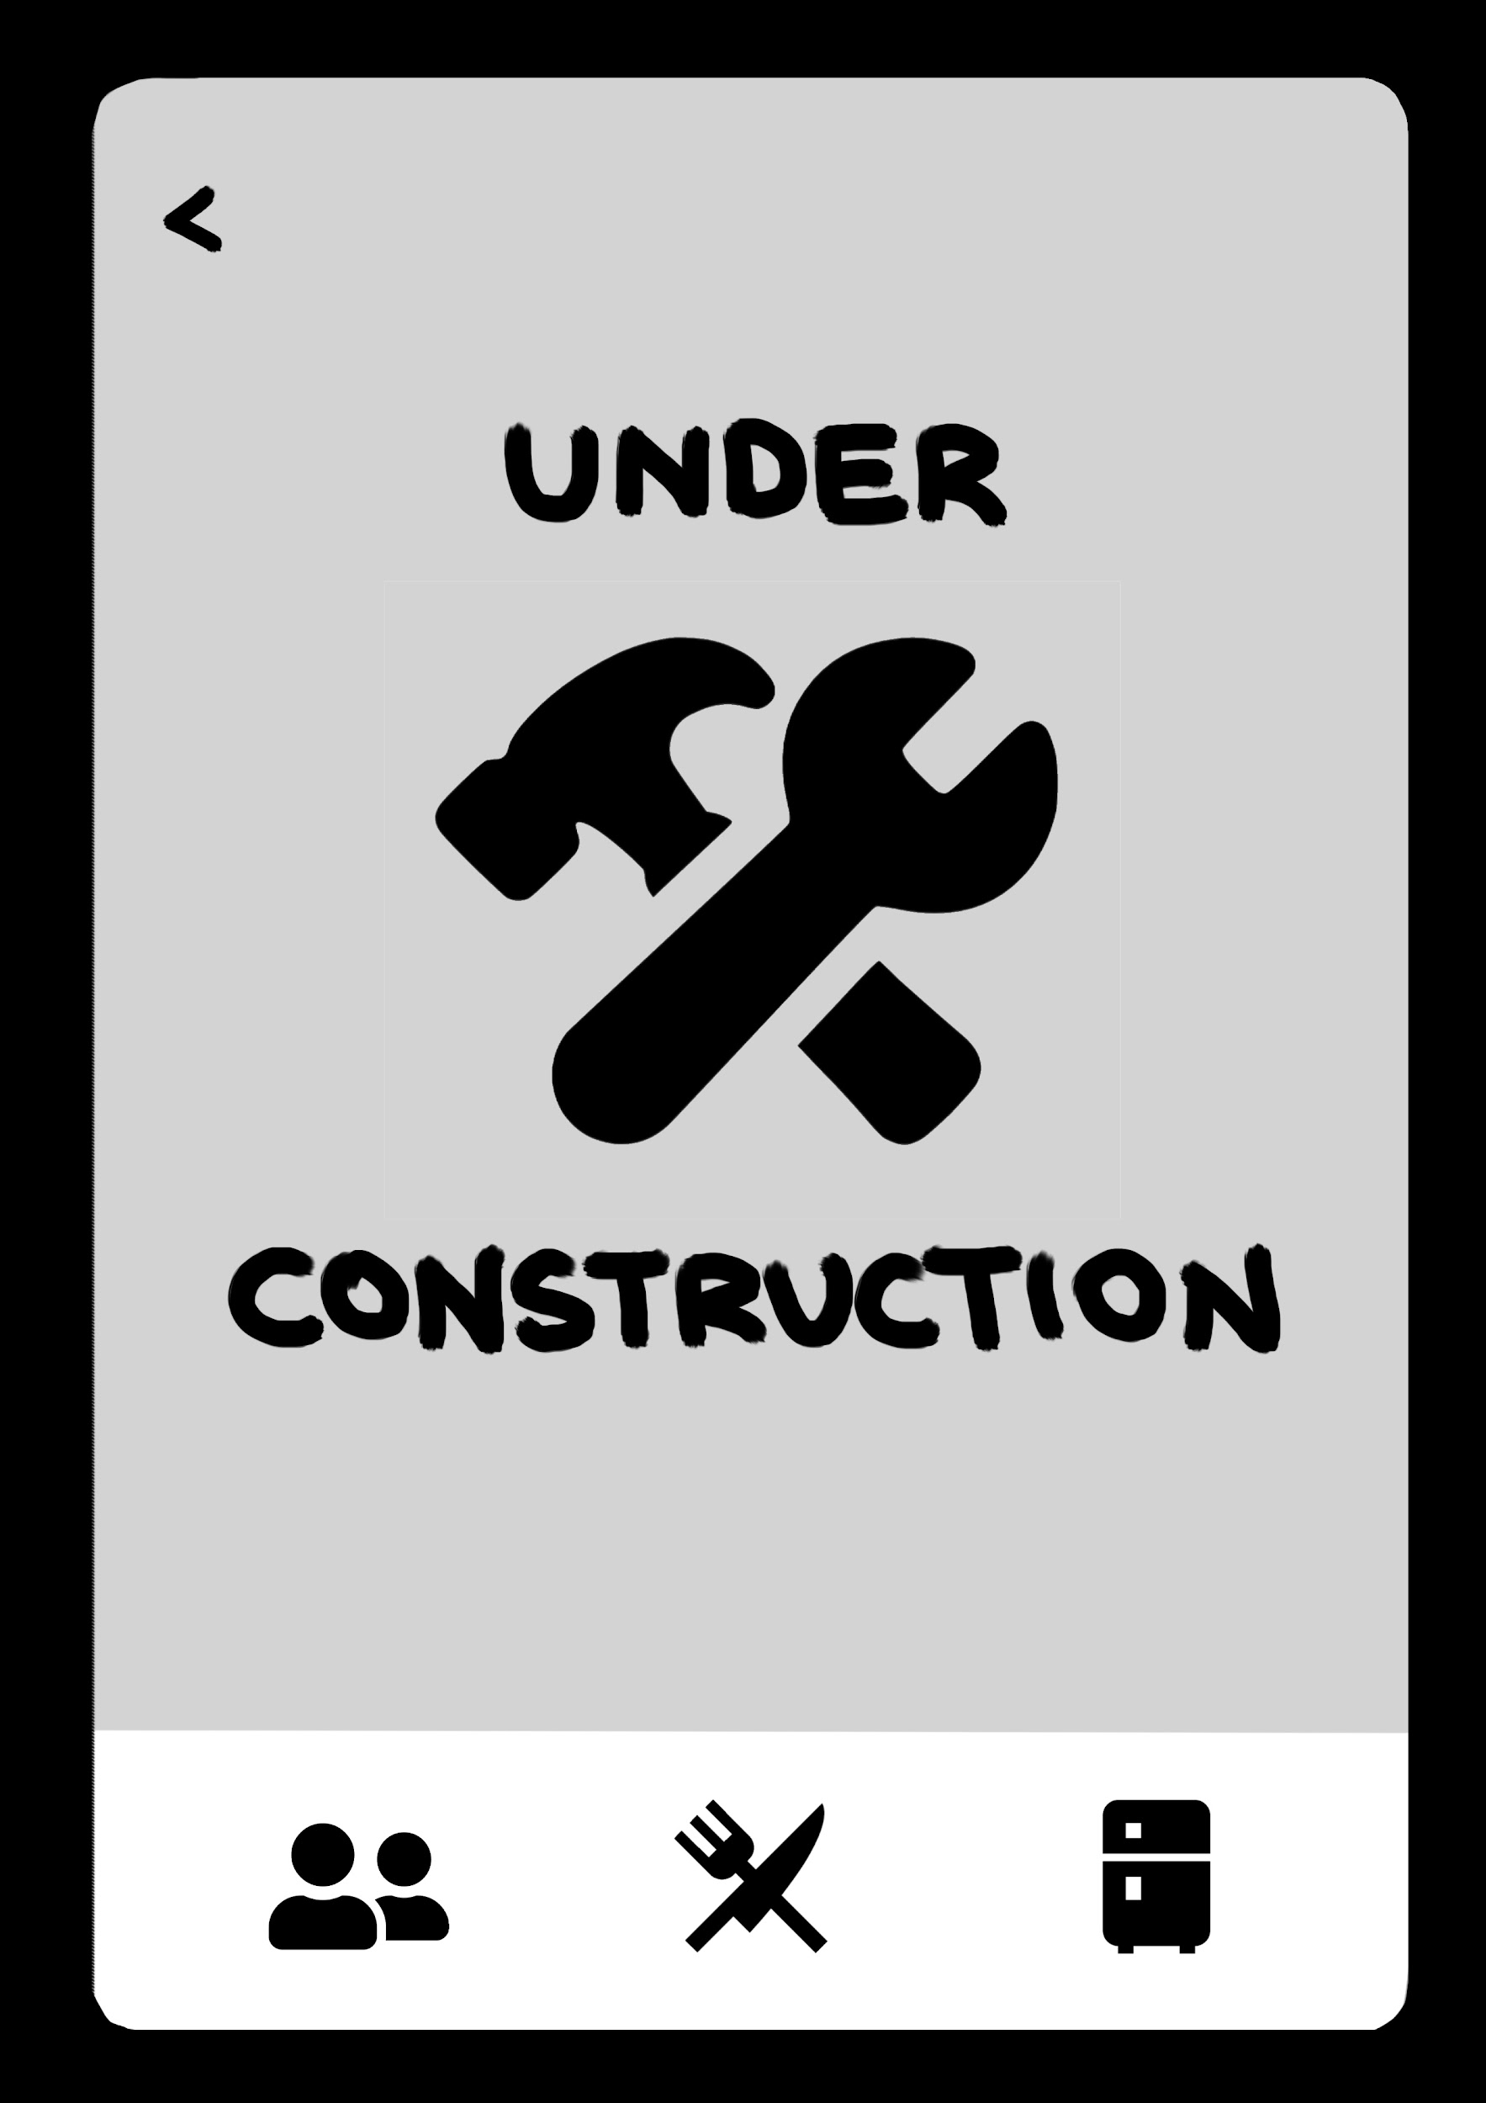

Lo-Fi Prototype Screens
Challenges (Landing)
15-Min Mussels Challenge
Challenge Interactions (Task 1/2;
simple + moderate) (Pinned vs. Unpinned)
Misc Assistive Lo-Fi Pages

Slide 25
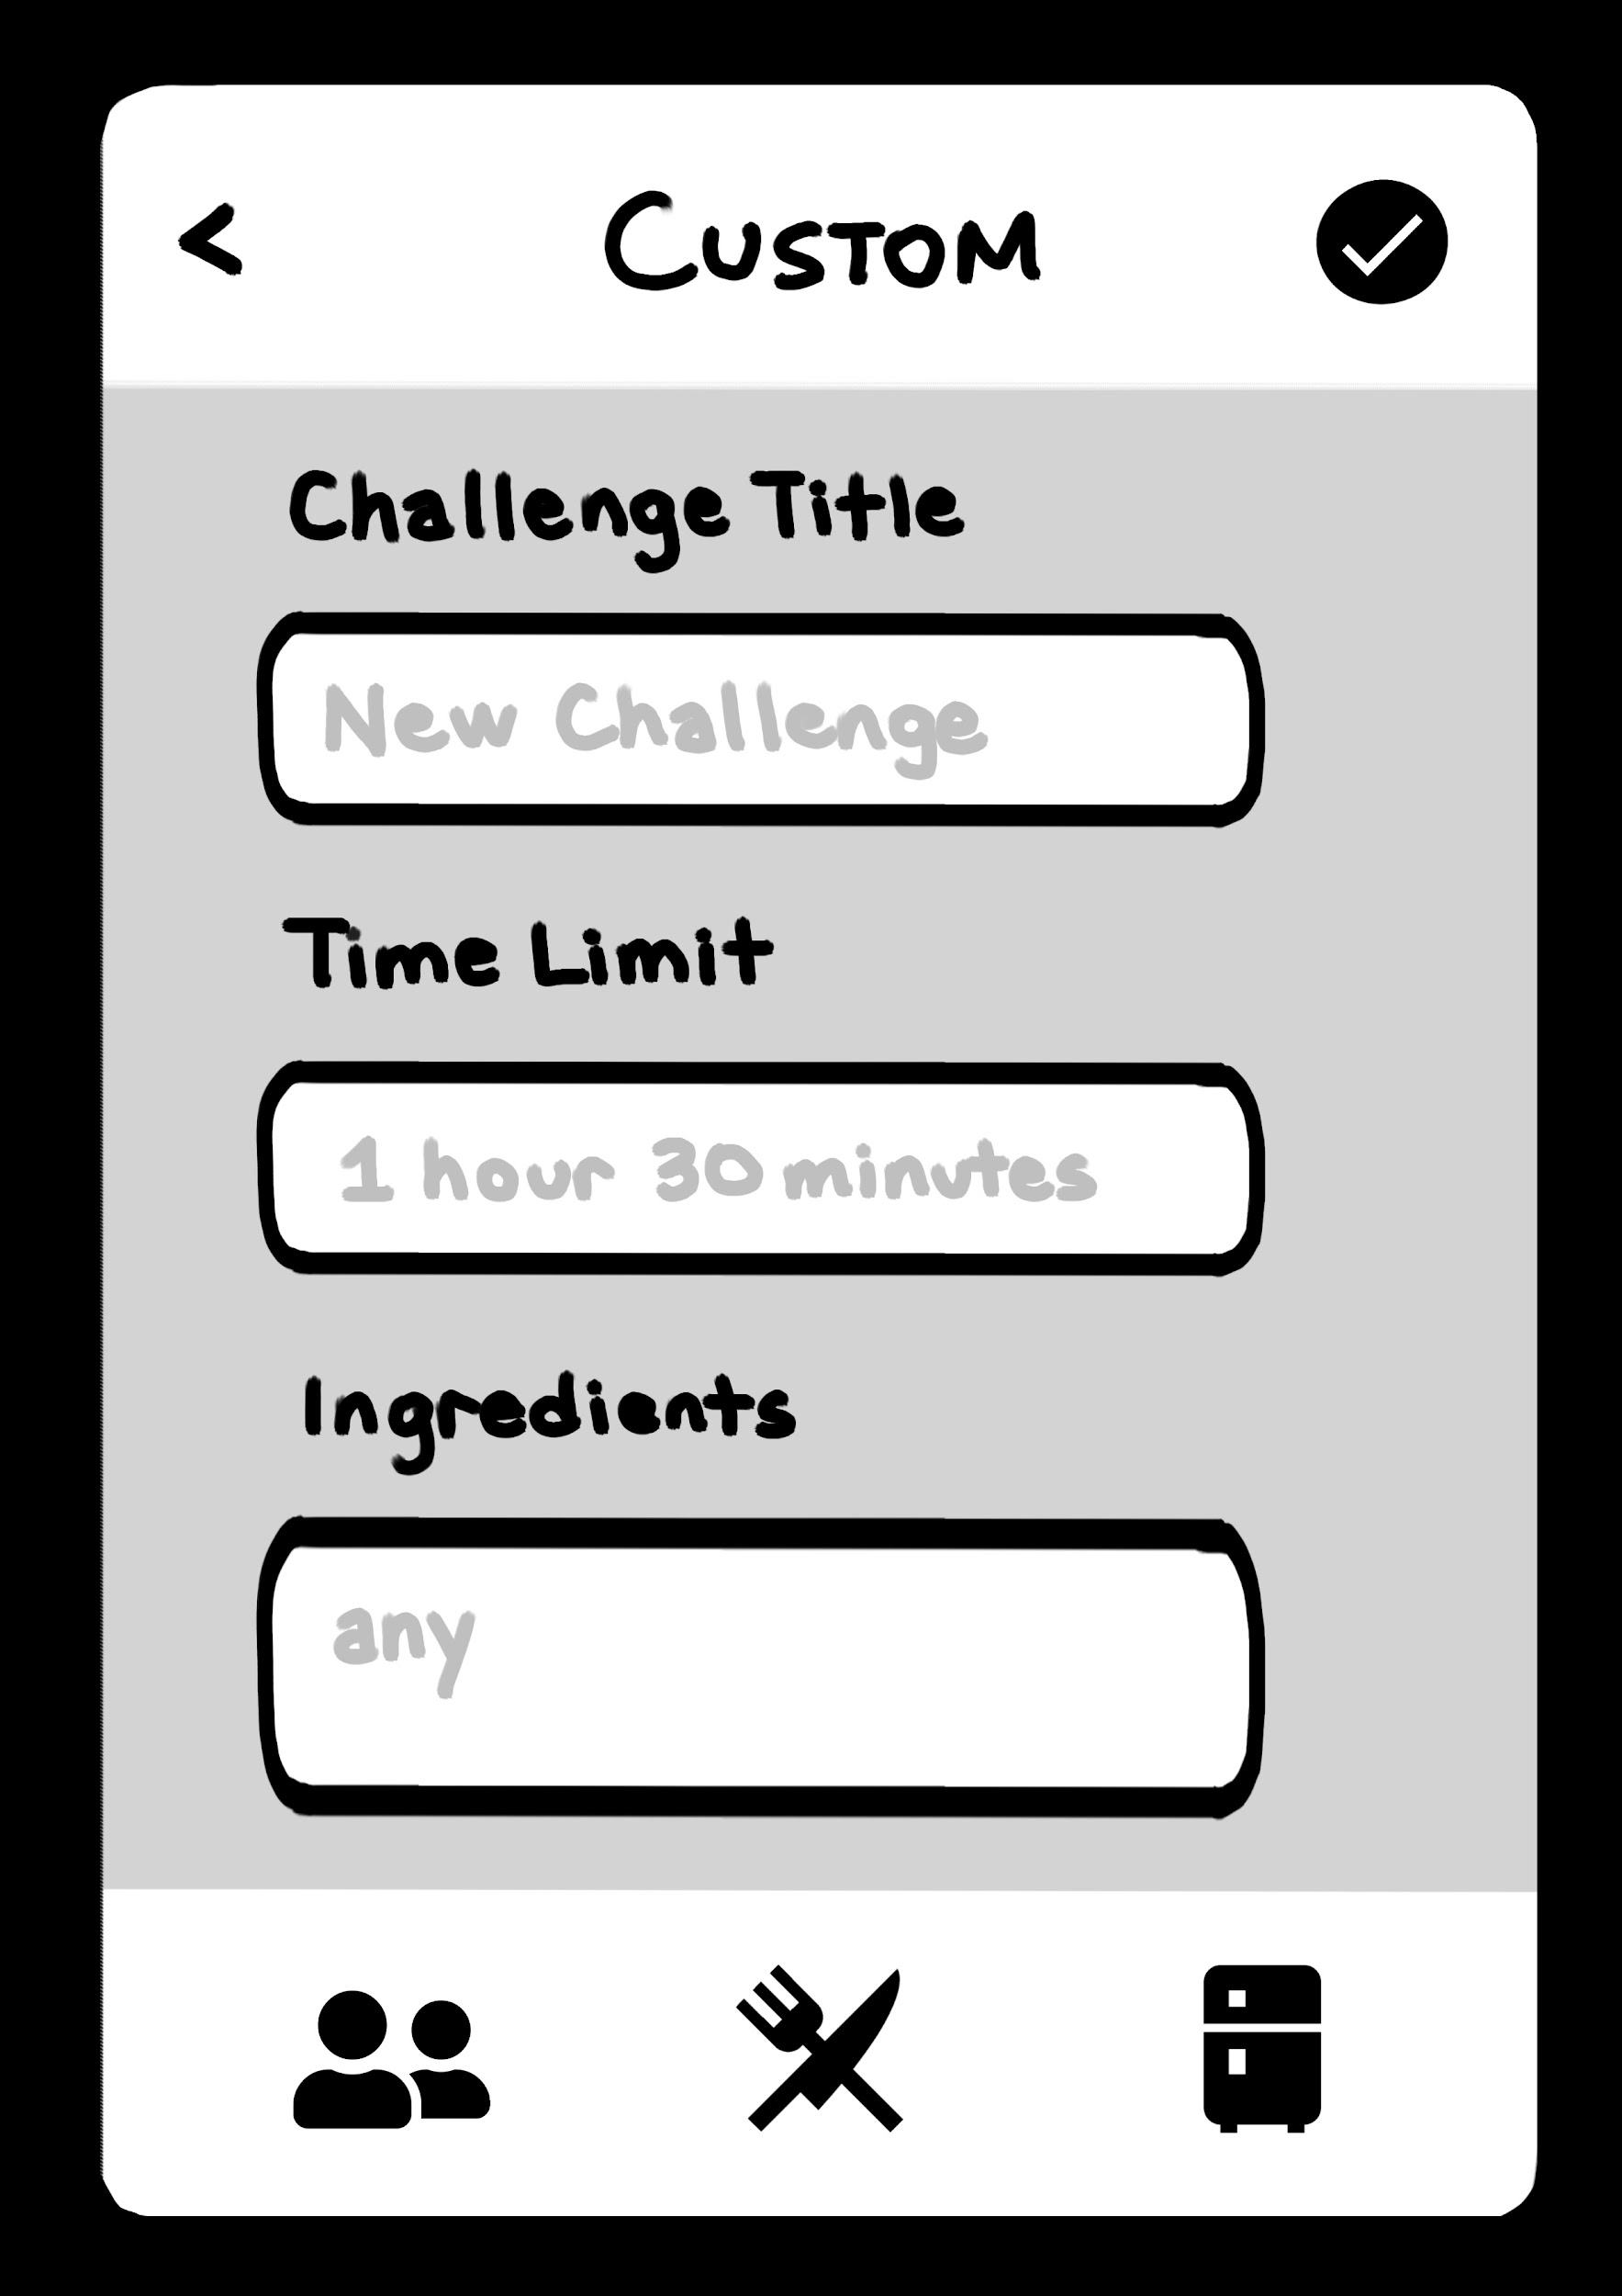
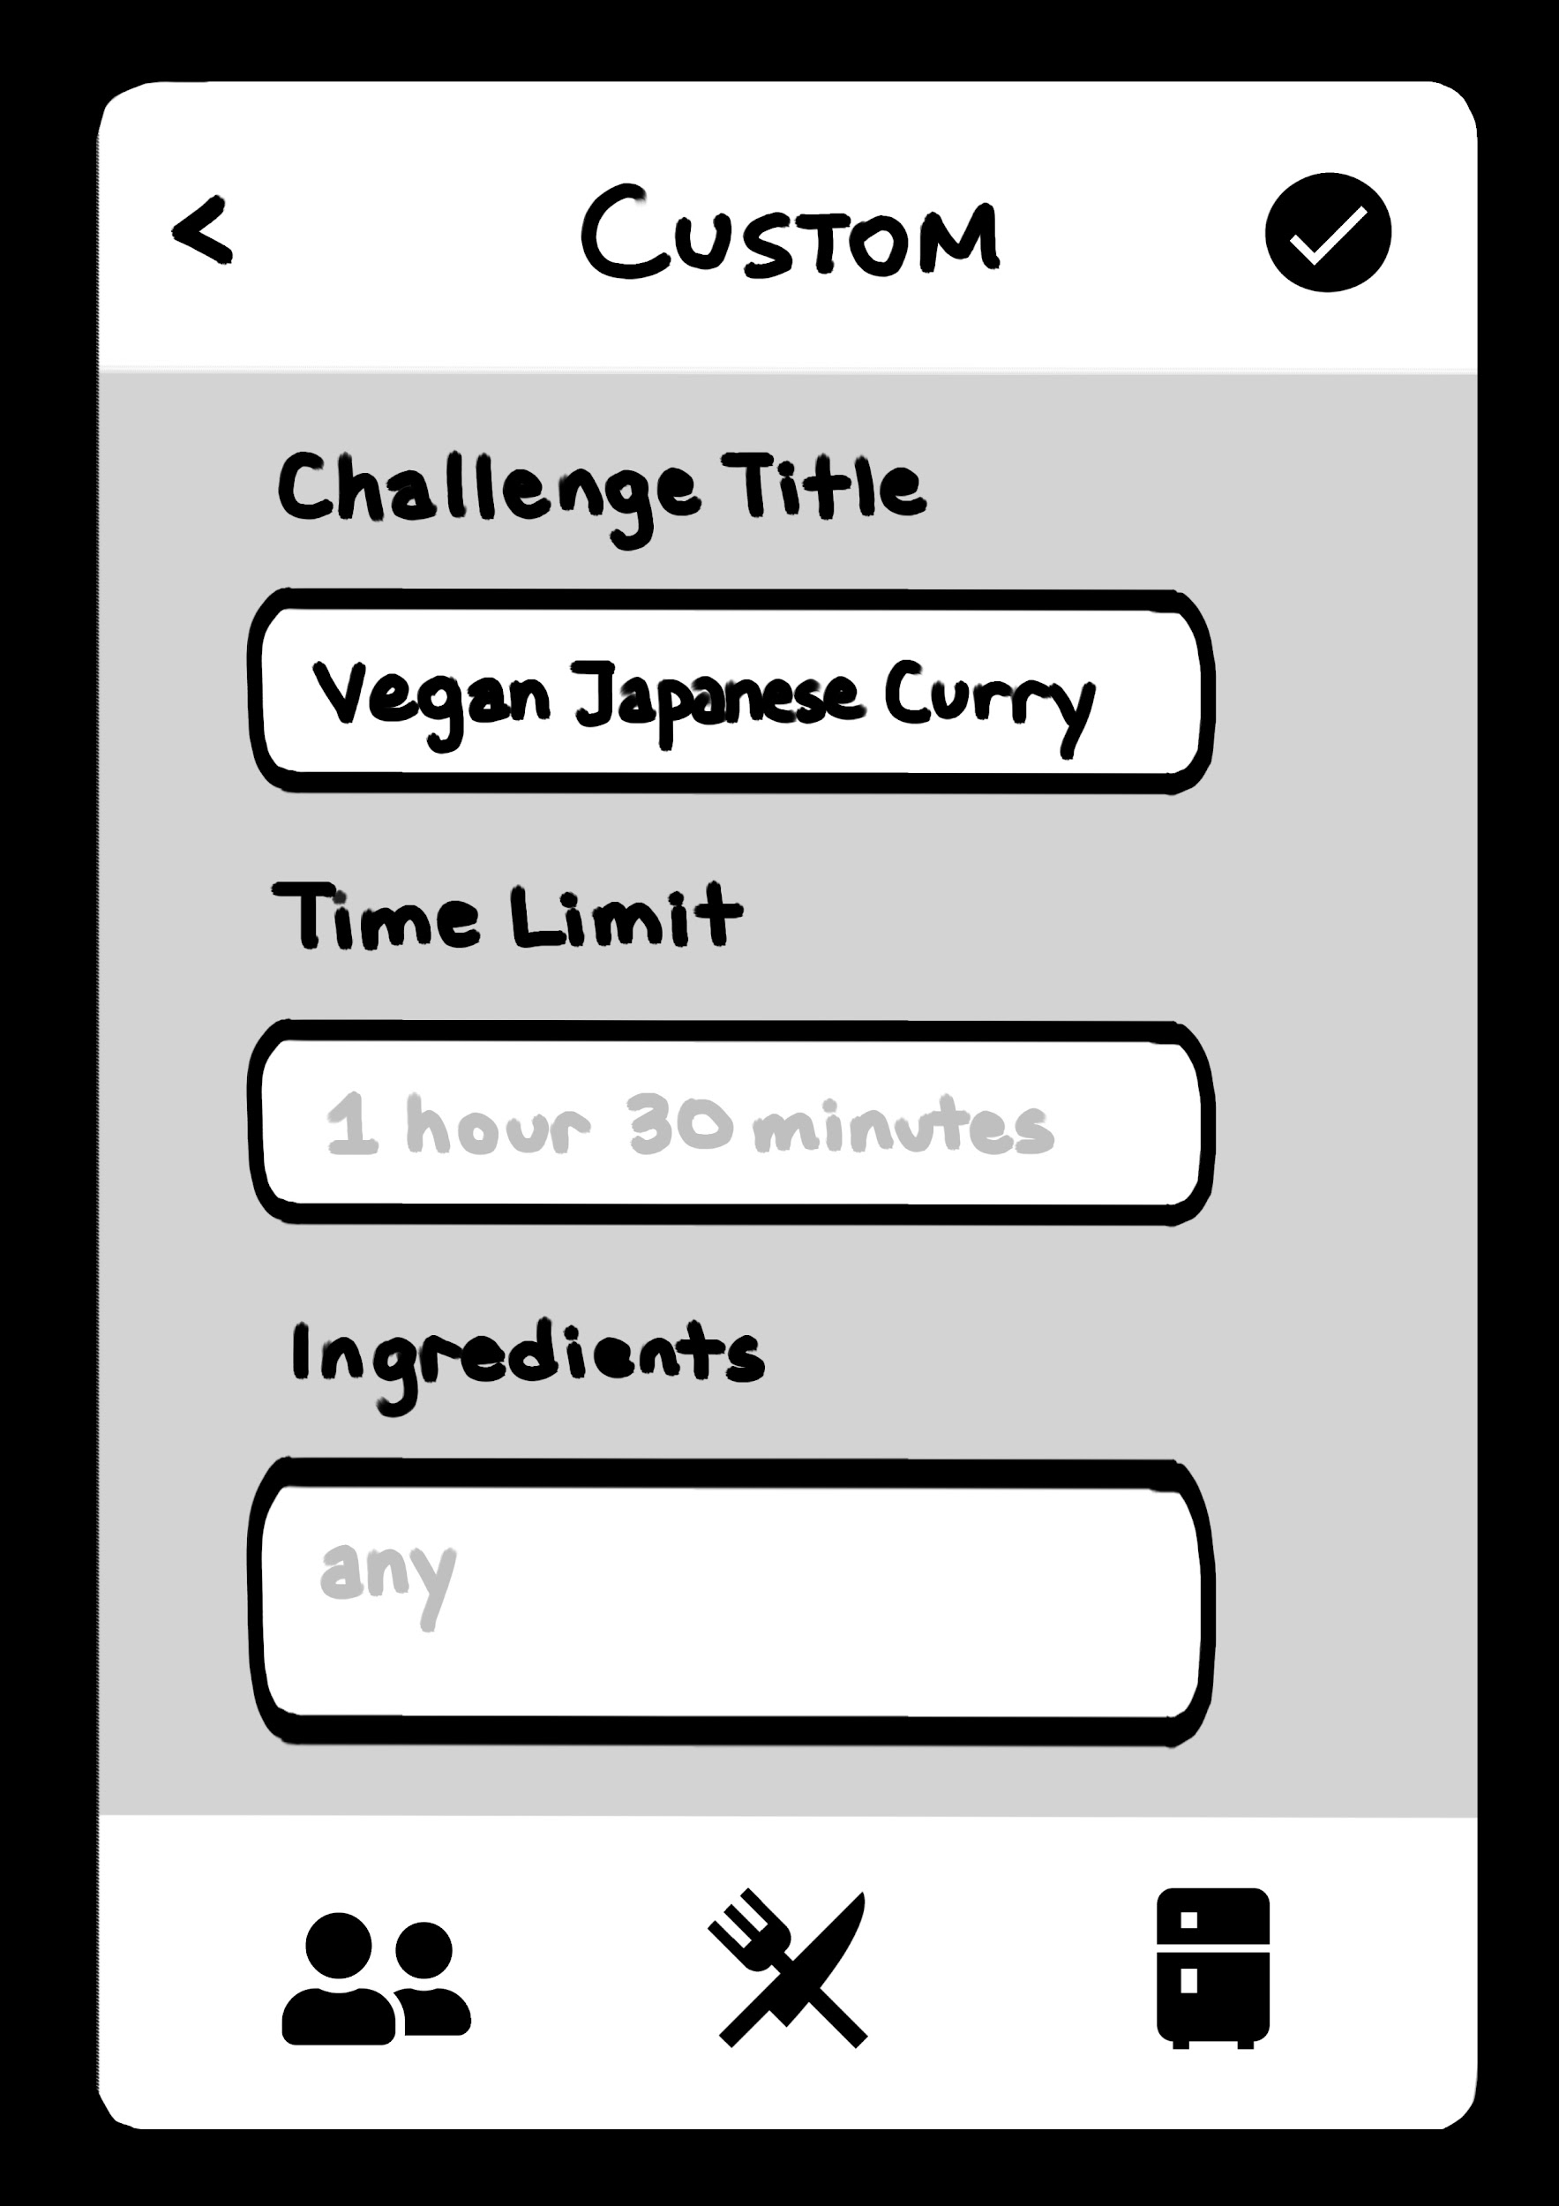
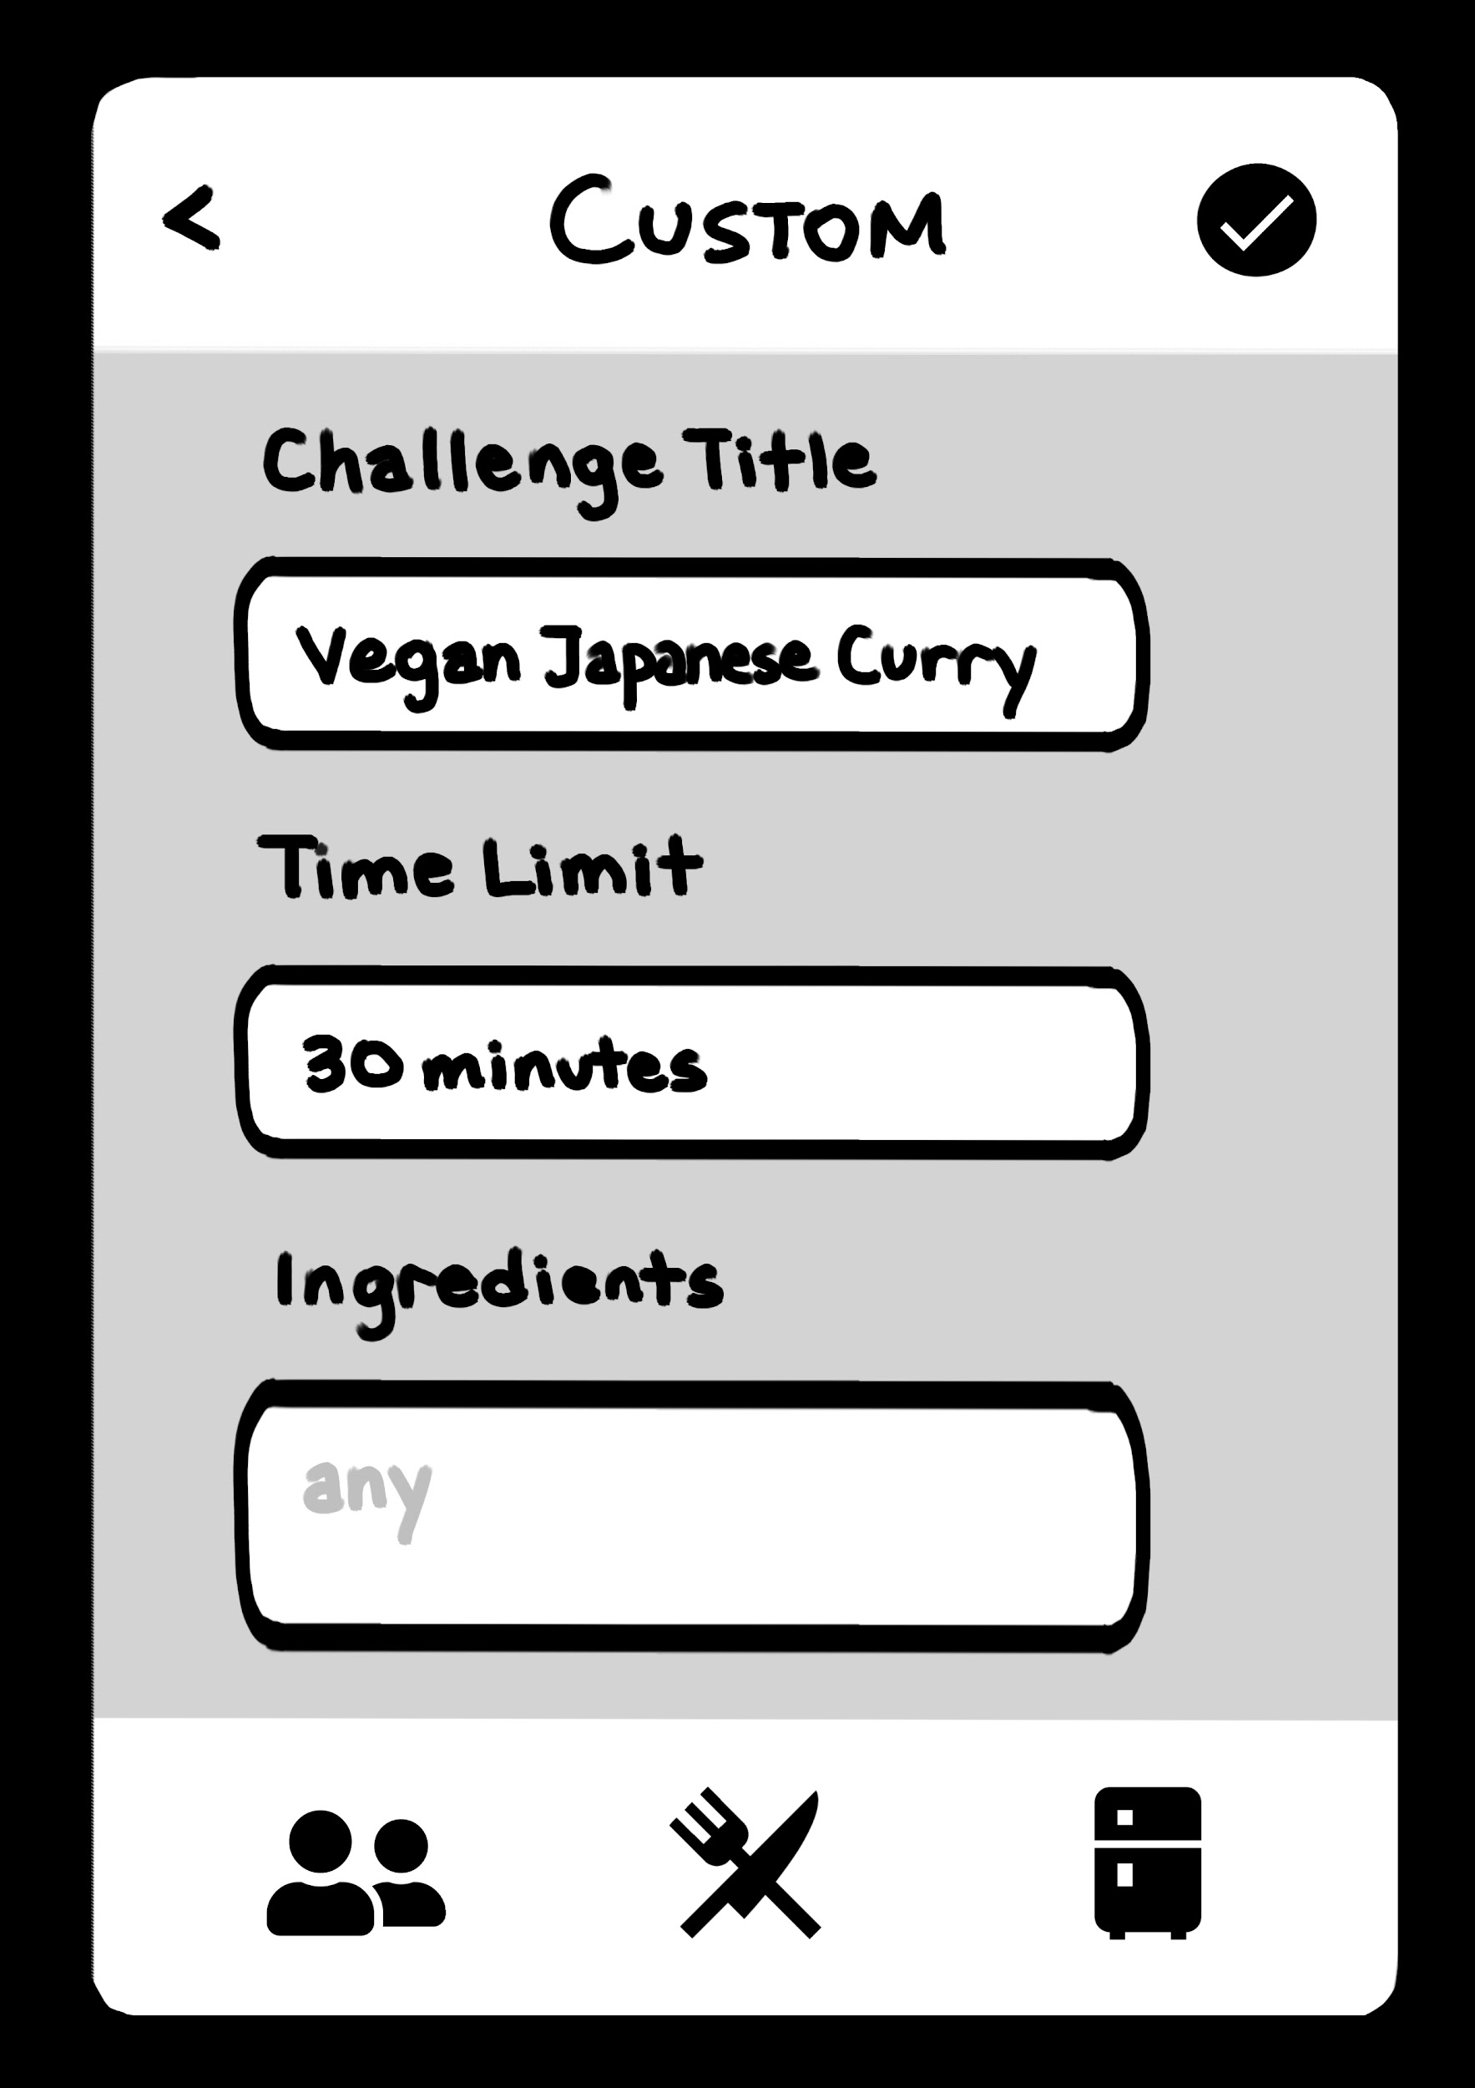
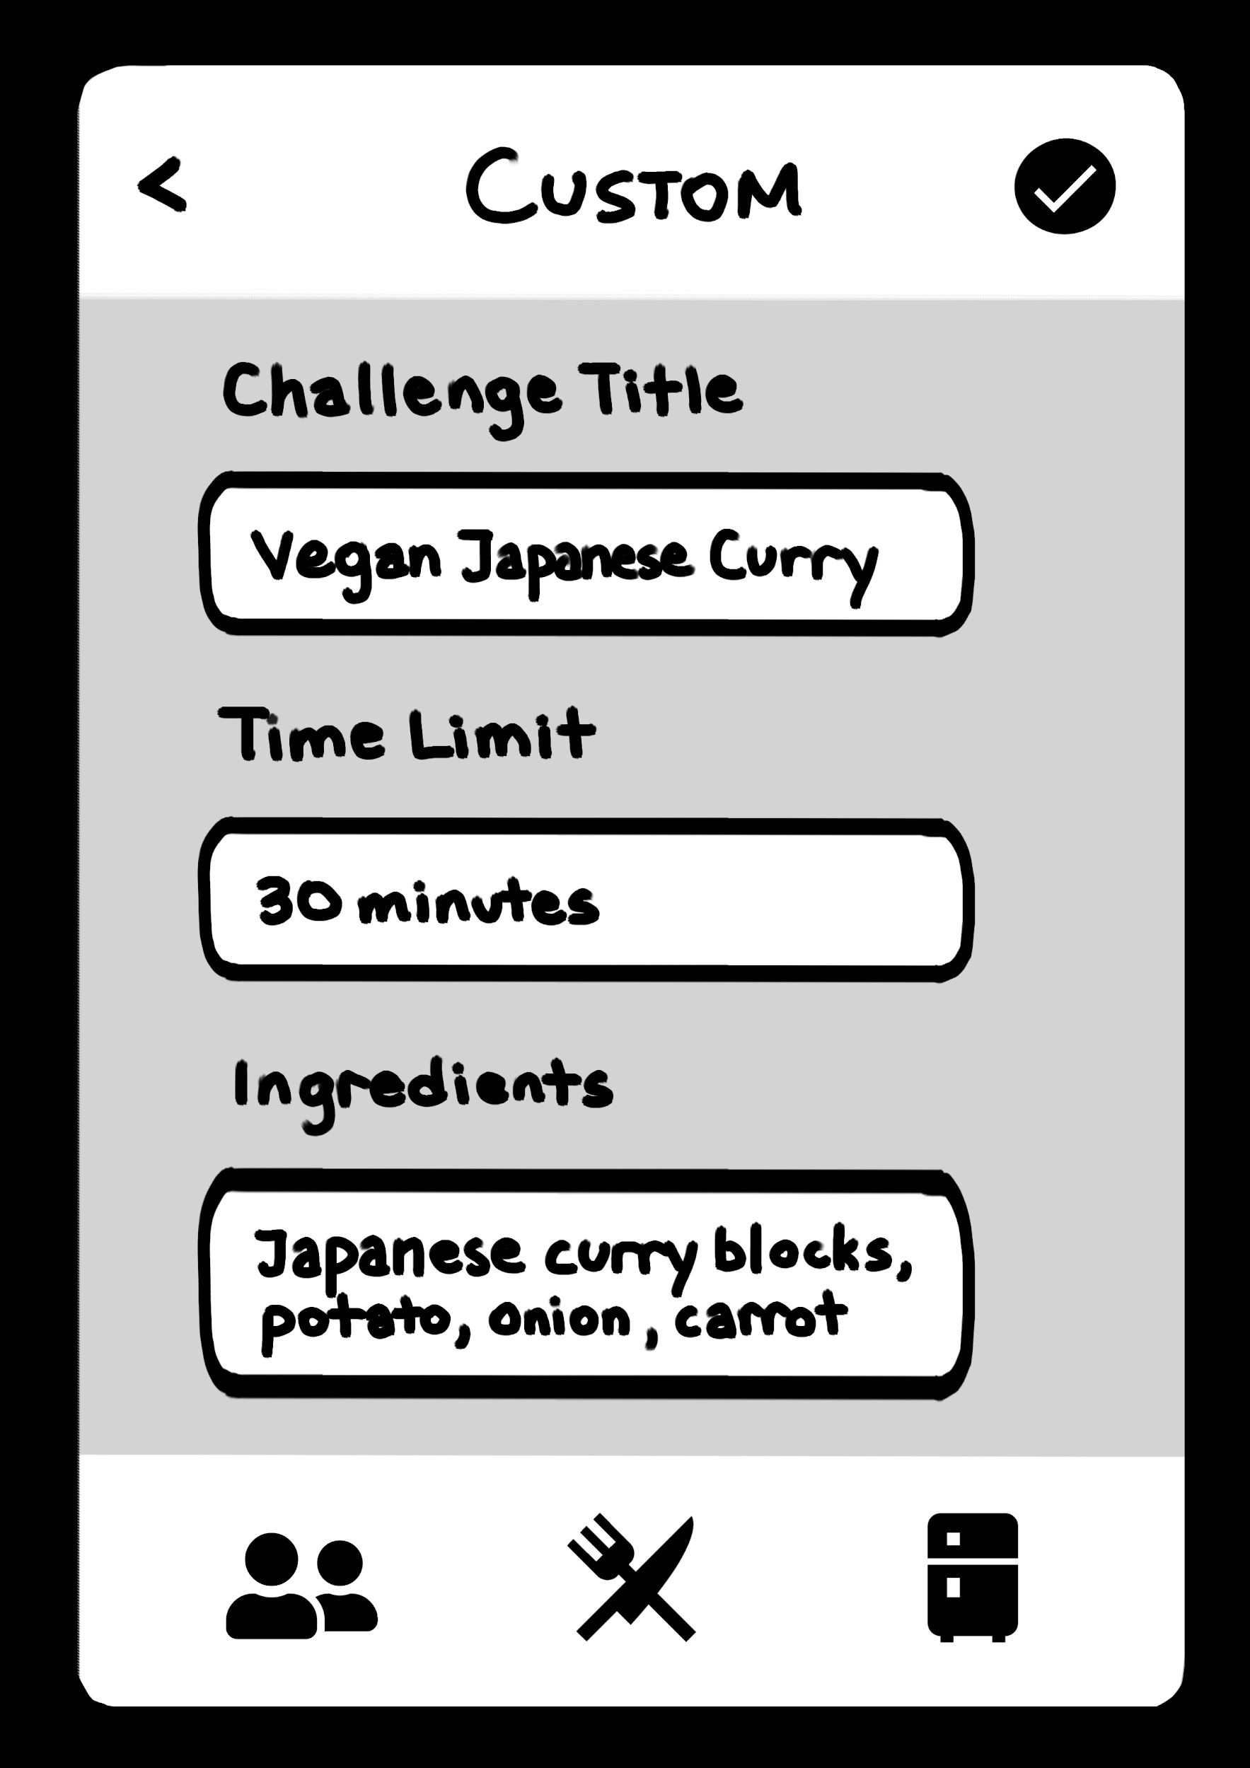
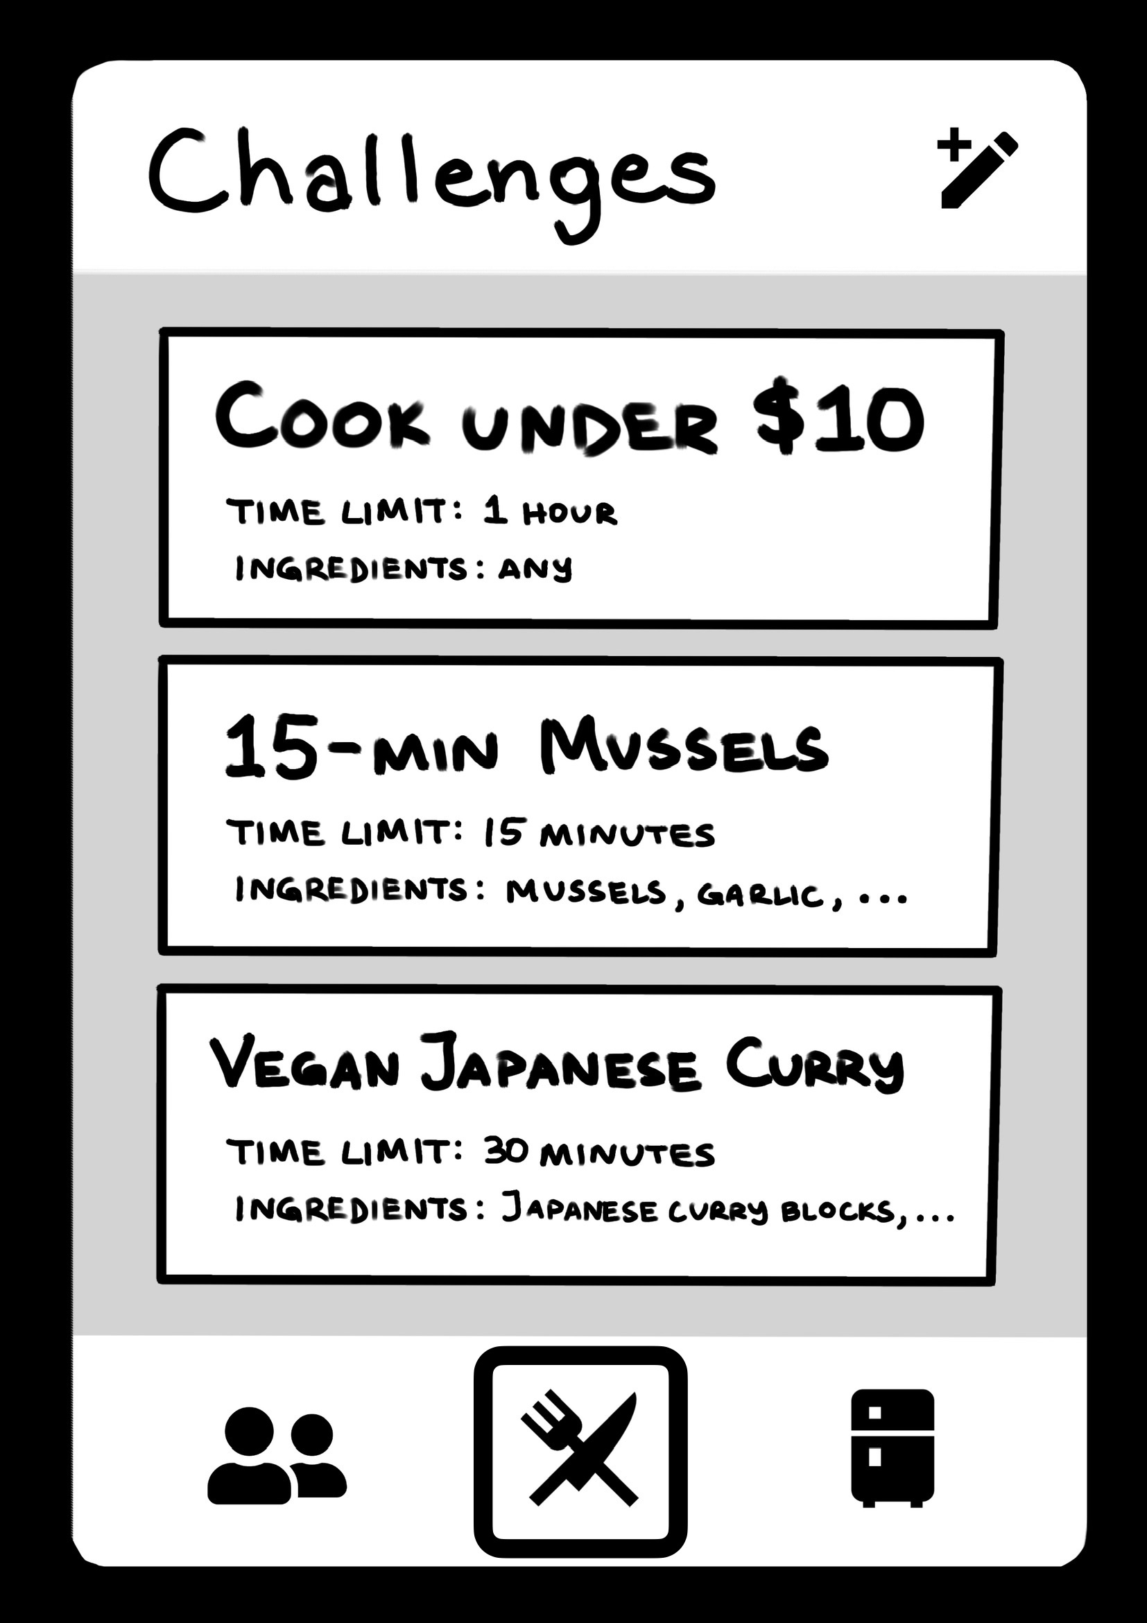
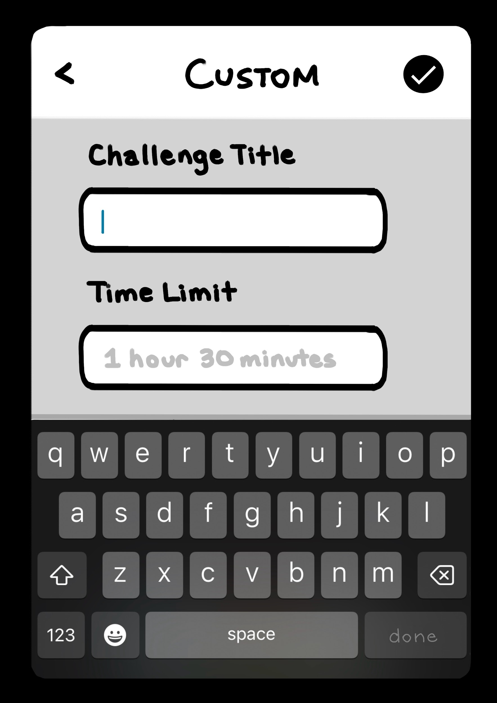
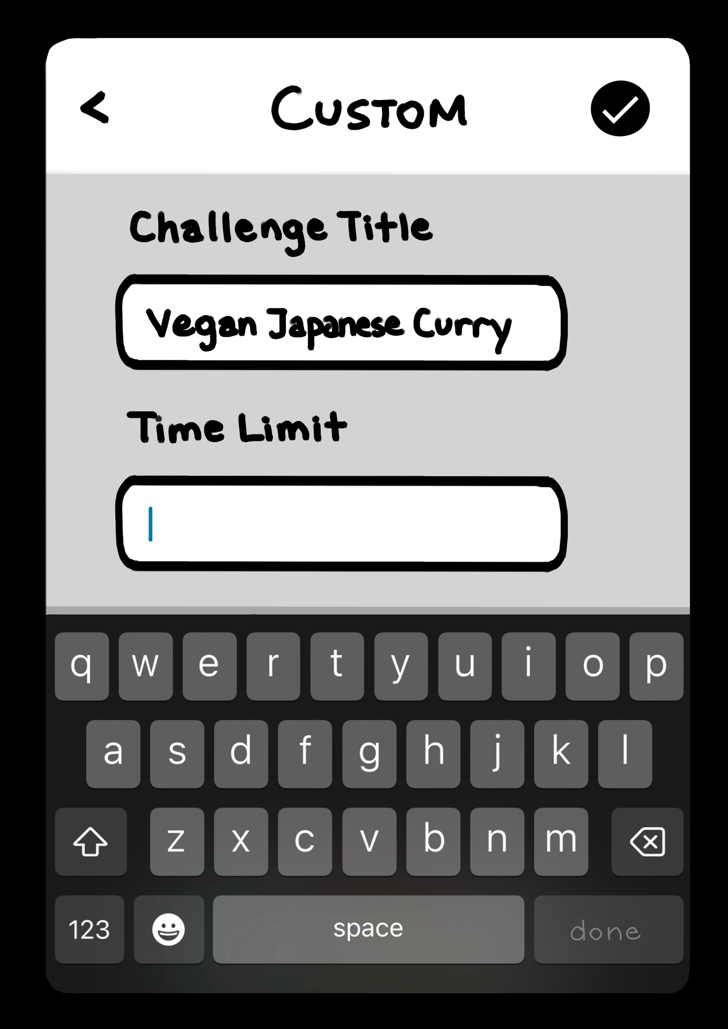
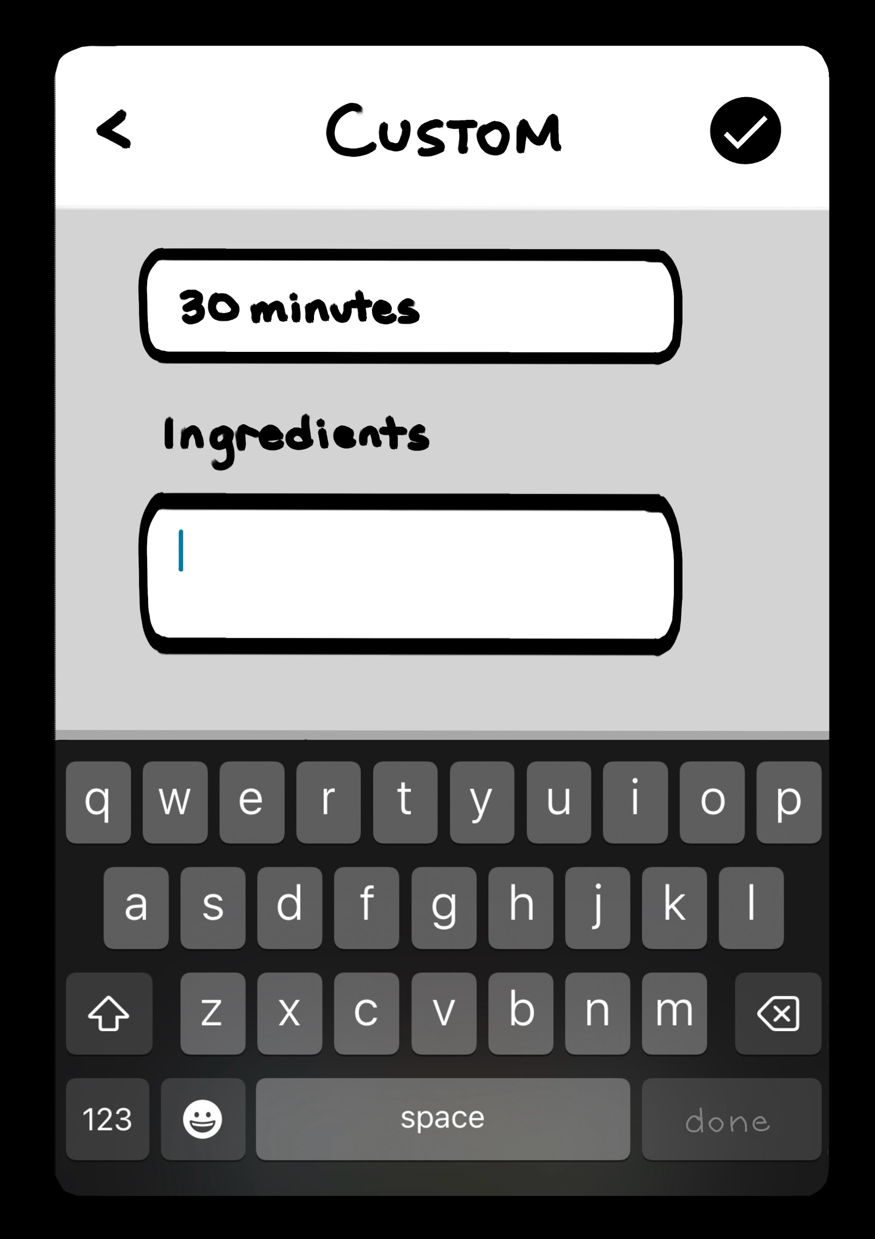
Lo-Fi Prototype Screens
Challenges (Landing)
Custom Challenge Pages (Task 3; complex)
Final Updated Challenges
(Landing) Page

Slide 26
Task Flows
Notes:
Here by 5:00

Slide 27
Task Flows
Simple: Save a Challenge to your fridge
  2 taps from landing page
Moderate: Send a Challenge to a specific friend
  3 taps from landing page
    2 taps after simple task to return to landing page
Complex: Create a new, custom challenge
  1 tap from landing page
  alternate 3x → tap entry box, type
  1 tap (confirm) on the custom challenge page

Slide 28
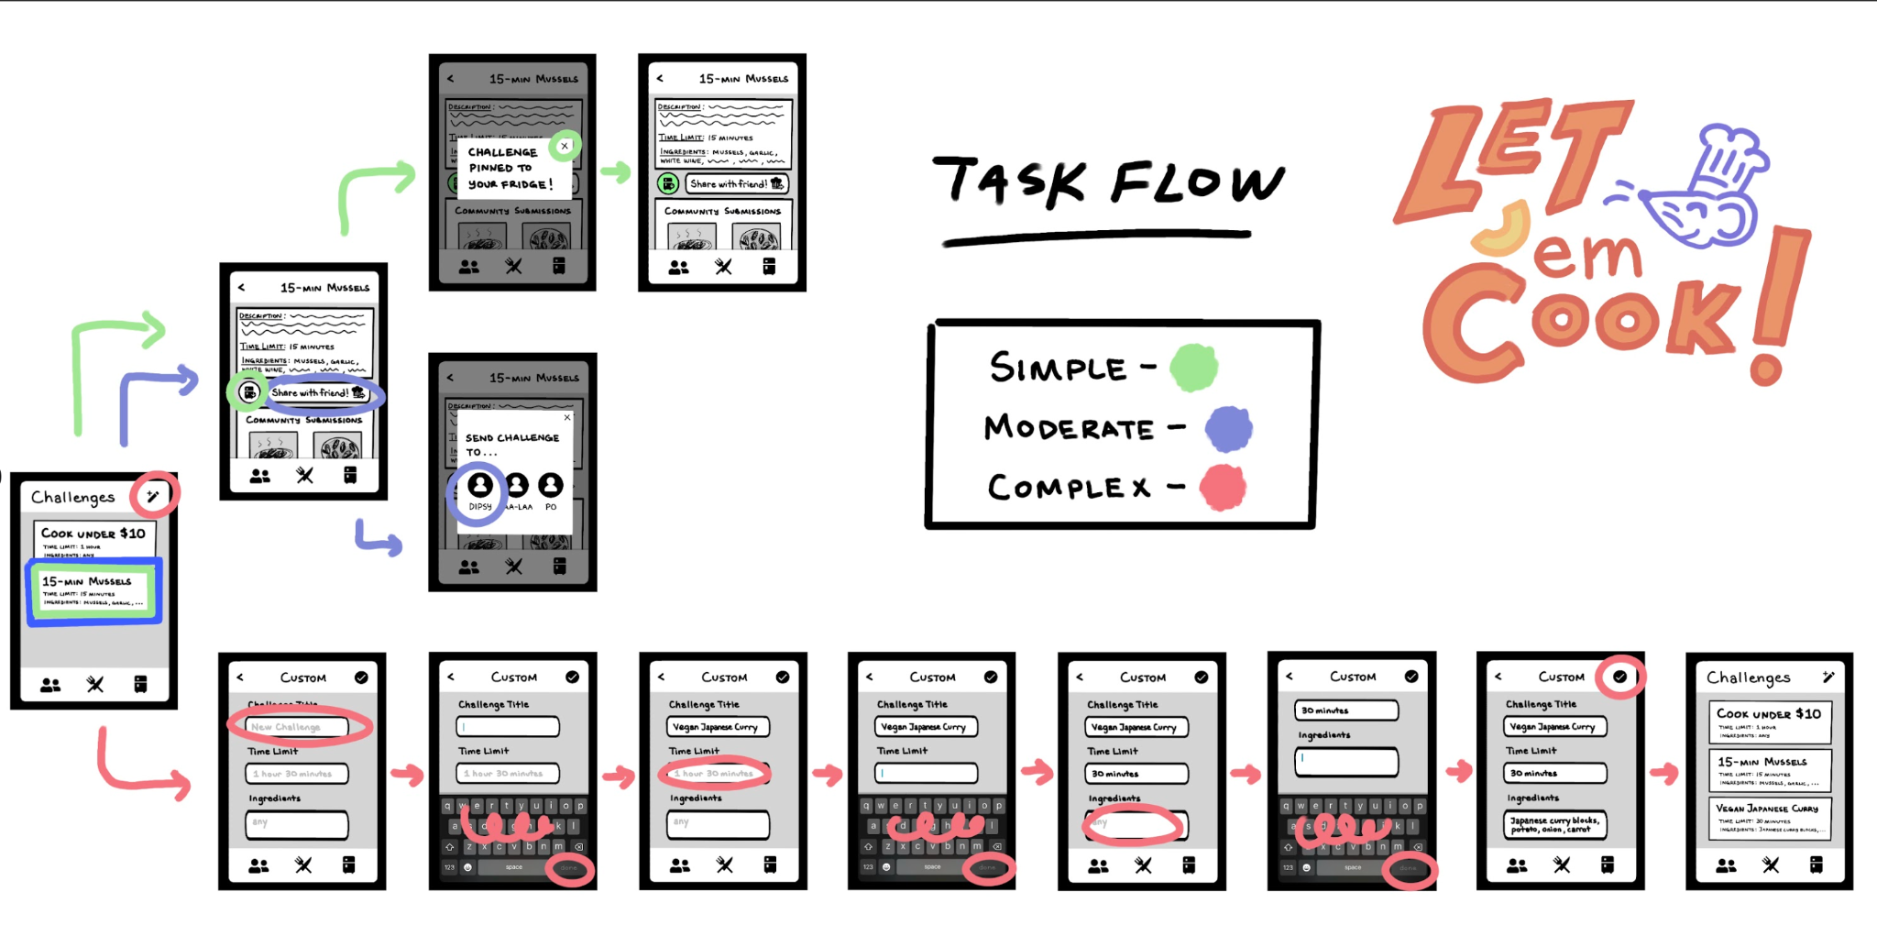
Overall Task Flow

Slide 29
Simple Task
Popup Closer
Fridge Button is Green if currently Pinned!
(Also appears on Fridge Tab)
"Save to Fridge" Button
(Task Complete By This Point)

Slide 30
Moderate Task
"Share With Friend" Button
Friend Selection

Slide 31
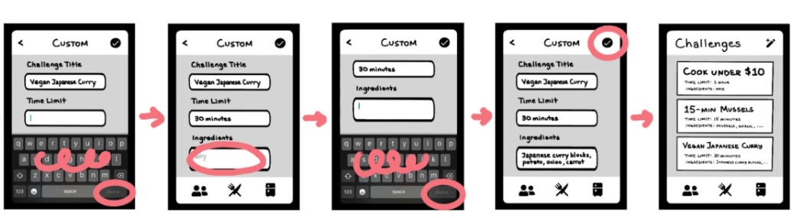
Complex Task
"Create Challenge" Button
Confirm Button
Text Boxes
Keyboard Popup
Repeat as seen in initial Diagram
Friends, Challenges, and Fridge Tabs

Slide 32
Testing
Methodology
Notes:
Here by 6:00 (5 minute warning)

Slide 33




Testing Methodology - Participants
4 participants, SJSU seniors met through mutual friends
Both were offered drink from Voyager Craft Coffee
  "Sharon" → female, lives with parents but buys own groceries and cooks own meals
  "Cary" → female, lives in a studio apartment and cooks for self, but often eats out when "tired or something"
Both were offered drink from Tootsie's at Cantor
  "Henry" and
  "Jordan" → roommates, both male, typically make cold lunches and eat out for dinner
  (they also perused the gallery afterwards)
Notes:
dont describe too much

Slide 34
Testing Methodology - Environment
Group 1: Sharon and Cary: at the CoDa Garden Level
Group 2: Henry and Jordan: outside MacMurtry/Cantor
For Both Groups:
Paper Prototype used, with computer, notetaker, and script/task reader

Slide 35
Testing Methodology - Procedure
For Both Groups:
Notetaker: Esaw
Script Reader / Primary Communicator: Mayowa
Computer (scheduling conflicts)
  Group 1: Tina
  Group 2: Butch
Process:
Explained Project Scope (Interface), Consent Forms
Presented Landing Screen
Read Script
Took Notes as Participant Interacted
Refrained from intervention, but answered clarifying questions

Slide 36
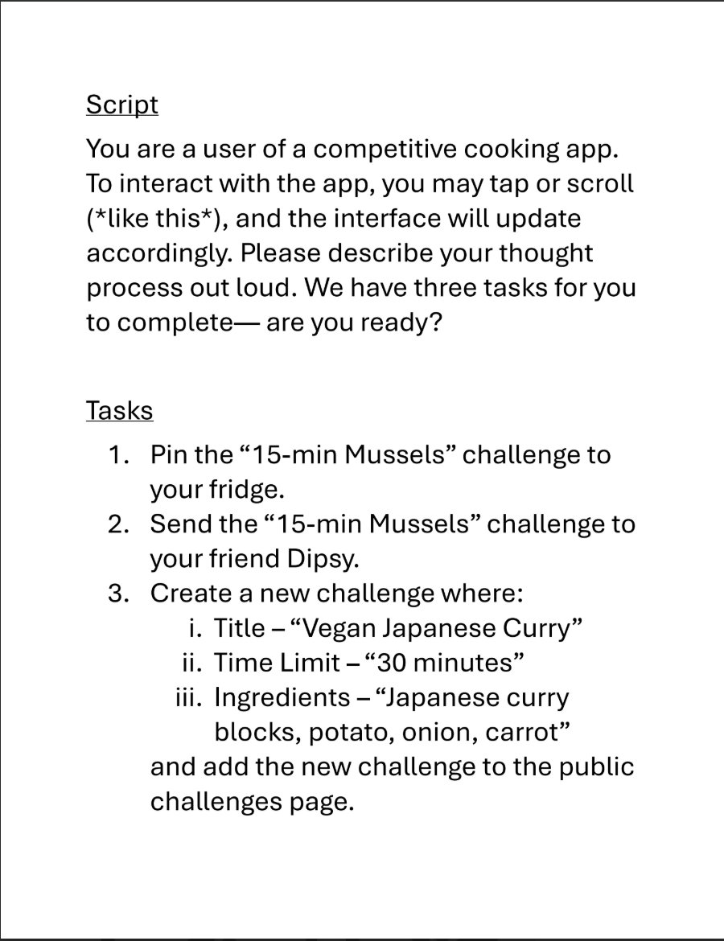
Procedure
(Tasks covered by paper and revealed one at a time)

Slide 37
Testing Methodology - Goals + Measurements
Goal 1: Efficiency/Speed
Time Taken to Achieve Task
measured in seconds
Dictates simplicity and relative connection of UI
Goal 2: Clarity/Confusion
Number of "incorrect moves" towards accomplishing task
measured in taps
Dictates confusing elements, balances goal 1 for speedier individuals
Notes:
Here by 7:00

Slide 38
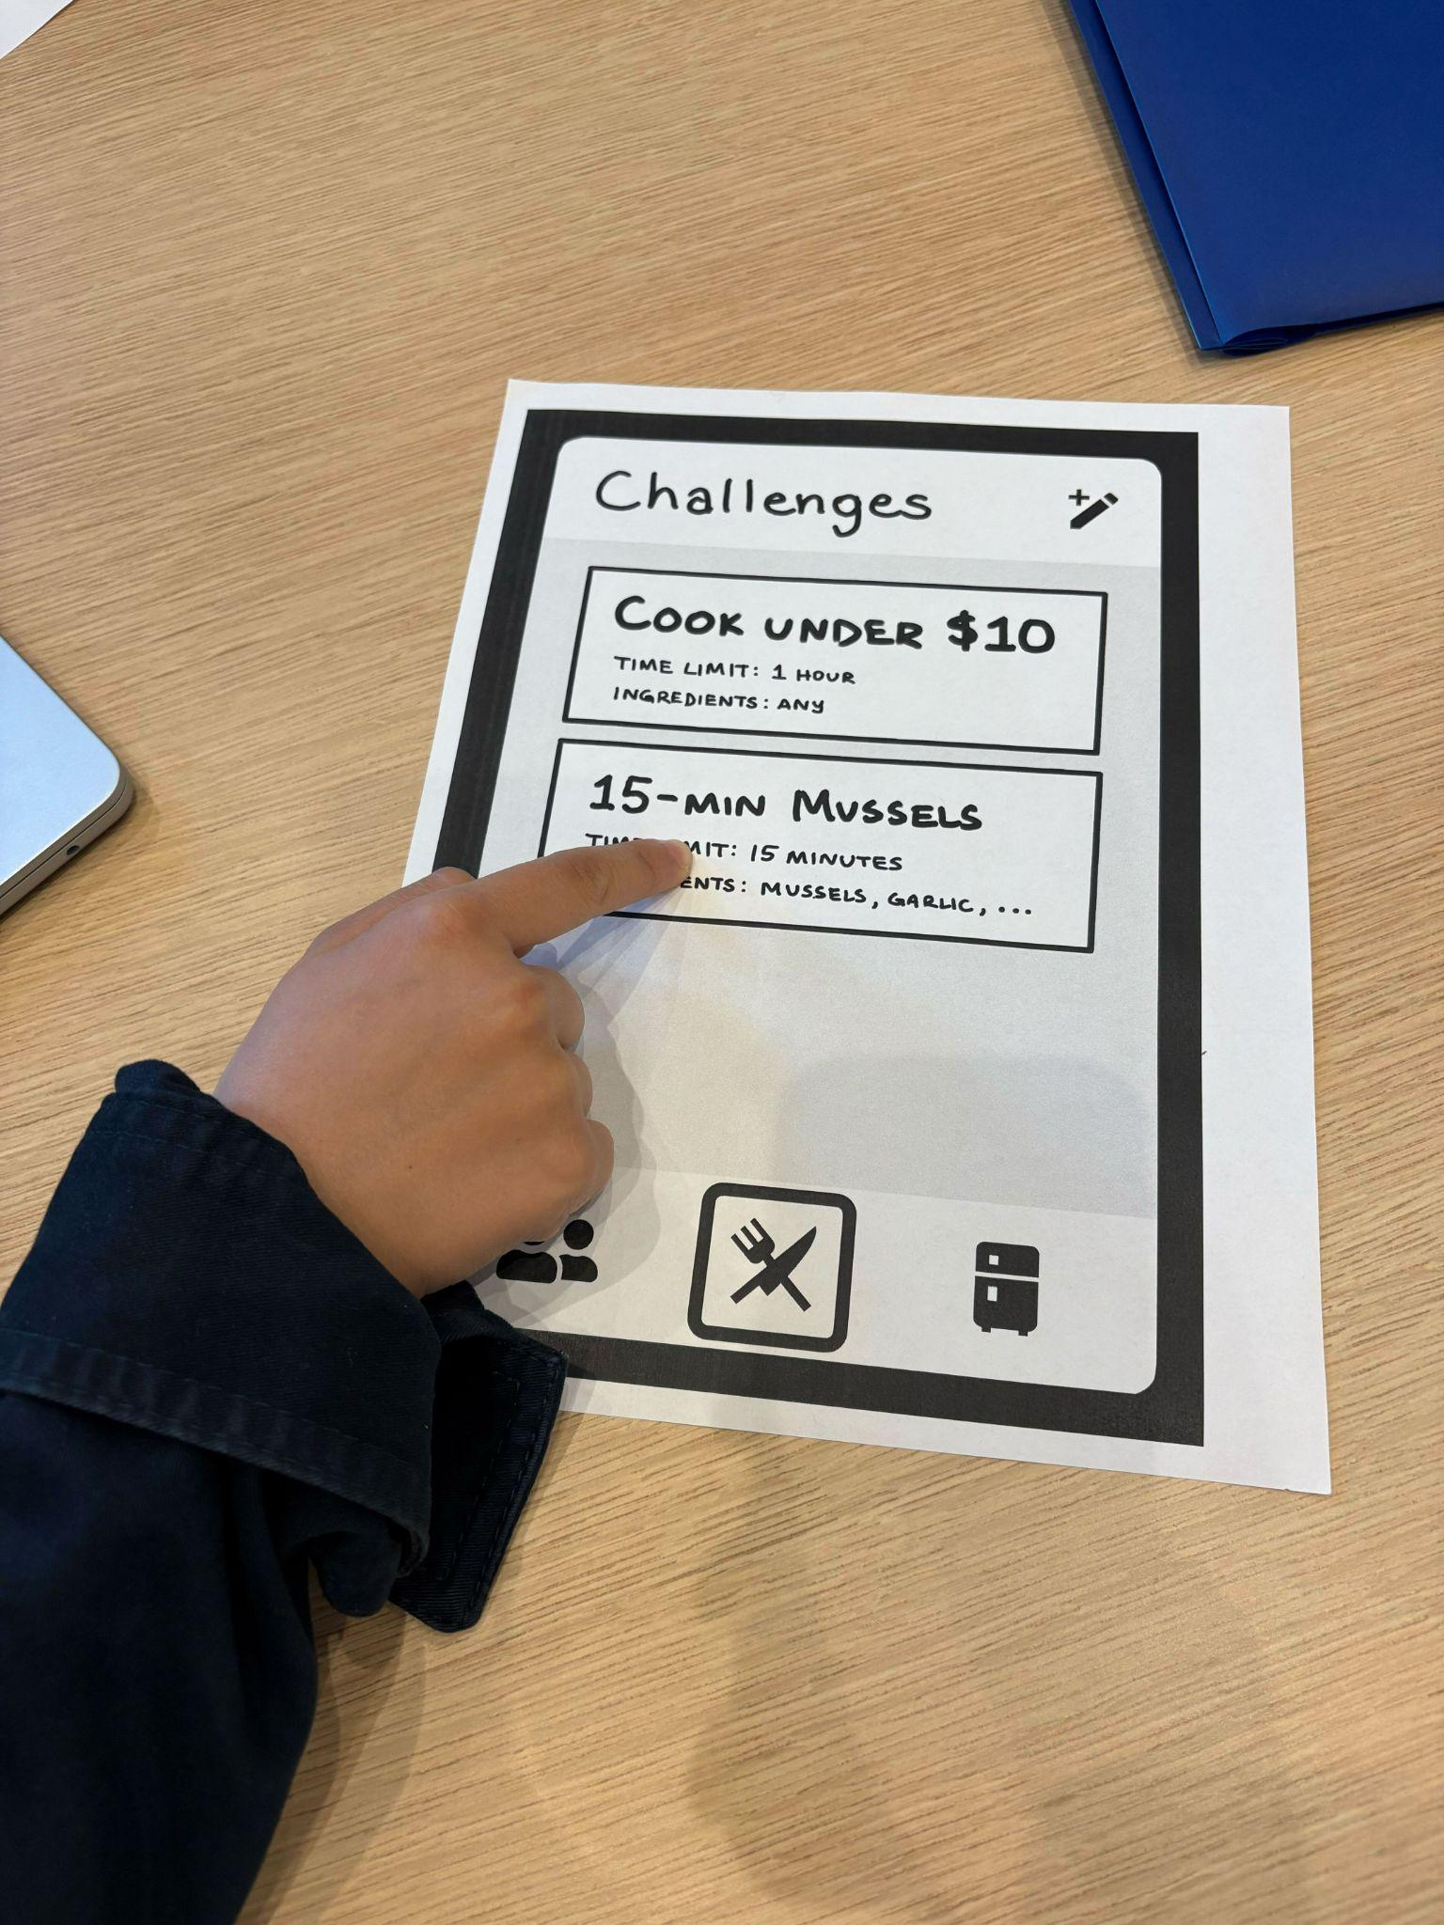
Testing
Results
(Sharon pointing)
Notes:
Here by 7:40

Slide 39
Testing Results - Data
Sharon
~30 seconds for task 1
~ 1 minute for task 2
~ 30 seconds for task 3
~2 incorrect moves
Cary
~ 1 minute for task 1
~ 3 minutes for task 2
~ 2 minutes for task 3
~ 7 incorrect moves
Henry
~ 1:30 minutes task 1
~ 2 minute task 2
~ 1 minute task 3
~ 4 incorrect moves
Jordan
~50 seconds for task 1
30 seconds for task 2
1:10 minutes for task 3
~2 incorrect moves

Slide 40
Testing Results - Goals Synthesized
Goal 1: Time Taken to Achieve Task
Most took < 5 minutes to complete all 3 tasks
Most delays were due to exploring screens unrelated to tasks
  Users didn't know what each screen mapped to at first
  Most quickly got out of exploration
Goal 2: Number of "incorrect moves" towards accomplishing task
"Exploring" counted as an incorrect move
Higher than desired; noted for discussion
Notes:
60s for testing results

Slide 41
Testing Results - Comments / Observations
Sharon
"What does fridge do?"
"Is [challenge page] just for me or…"
Cary
Looked at main page for long time without inputs
Didn't see pencil button
"I can tell what's happening in the app. It's simple."
Henry
Repeated unsuccessful actions (images)
"I understand it's meant to be social"
Confused pin/download in instructions
Jordan
"I thought that maybe you go to fridge and then there's an ADD button there"
Liked green upon adding challenge
"Competitive cooking app, sounds like a great idea" (noted novelty)
Liked "<$10 challenge" : "this is perfect"
Notes:
Skip this in presentation

Slide 42
Discussion
Notes:
Here by 9:00

Slide 43
Discussion
Users generally found simple, clean UI easy to use BUT
  some unintuitive icons/locations (fridge icon to pin to fridge)
  general confusion on each tab until explored
  general confusion on purpose behind some actions until post-explanation
CHANGES PLANNED:
  Labels/more text
  Lean into coloring items
  Onboarding/usage guide on app startup
Notes:
Finish by 10:00

Slide 44
Discussion - Possible Shortcomings
Doesn't test photo or voting feature/tasks
  Doesn't reveal any information on those tasks
No Fridge/Friends tab inclusions
  What other confusing connections might exist there?
No limit testing (# pinned ingredients, feed size, etc.)
Notes:
Get here with 60s remaining worst
11:00 is cap. Just overview as "we have things to look forward to testing for next prototype"

Slide 45
Thank You

Slide 46
Appendix

Slide 47
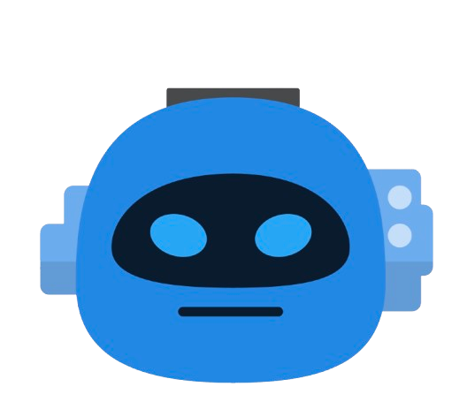
“Samantha” Revised POV
WE MET…
Samantha, a 24-year-old full-time software engineer at Pinterest who lives alone in an apartment in San Francisco.
WE WERE SURPRISED TO NOTICE…
that despite her appreciation for food as an experience, she defaults to cooking the same few easy recipes, opting for convenience over variety, even though budgeting and time aren’t a concern for her.
WE WONDER IF THIS MEANS…
that without a clear vision or recipe in mind, she finds it challenging to depart from what she’s culinarily used to, thus ultimately defaulting to one of her “go-tos,” even if they aren’t ideal flavor/complexity-wise.
IT WOULD BE GAME-CHANGING TO…
make experimenting with new meals feel engaging and prideful, sparking her sense of curiosity and accomplishment.

Slide 48
Smartphone vs. Smartwatch data
Sources on data:
Smartphone ownership: https://www.pewresearch.org/internet/fact-sheet/mobile/
Smartwatch ownership: https://pmc.ncbi.nlm.nih.gov/articles/PMC10883993/

Slide 49
Appendix (cont.) - critical incidents
Sharon (2)
Assumed "pin to fridge" meant go to fridge icon first (incorrect action)
Attempted to drag and drop recipe to fridge icon to pin
Cary (7)
Visited friends list
Visited fridge list
Pencil button early
Bounced between already-visited pages instead of visiting landing page

Slide 50
Appendix (cont.) - critical incidents
Hunter (4)
Tapped on food images (scrolled) for not 15-minute mussels
  Twice
Visited fridge
Tapped to "friends" despite saying "Let's go back home"
Jordan (2)
Immediately visited fridge
Then visited friends

Slide 51
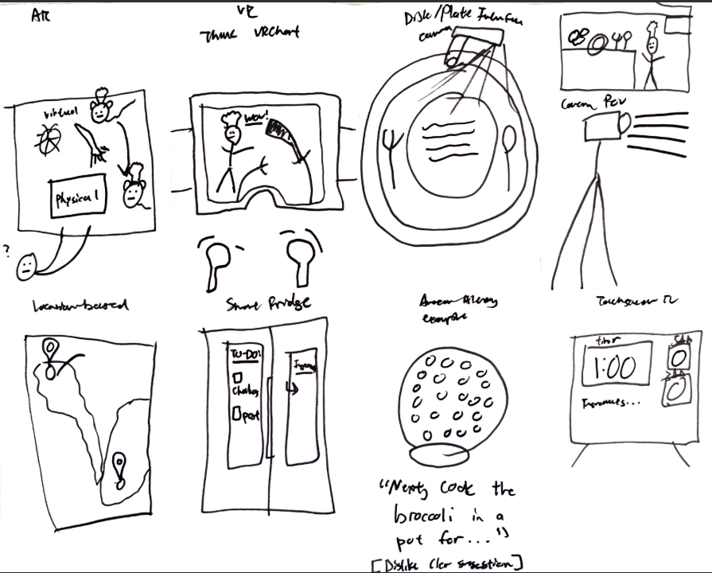
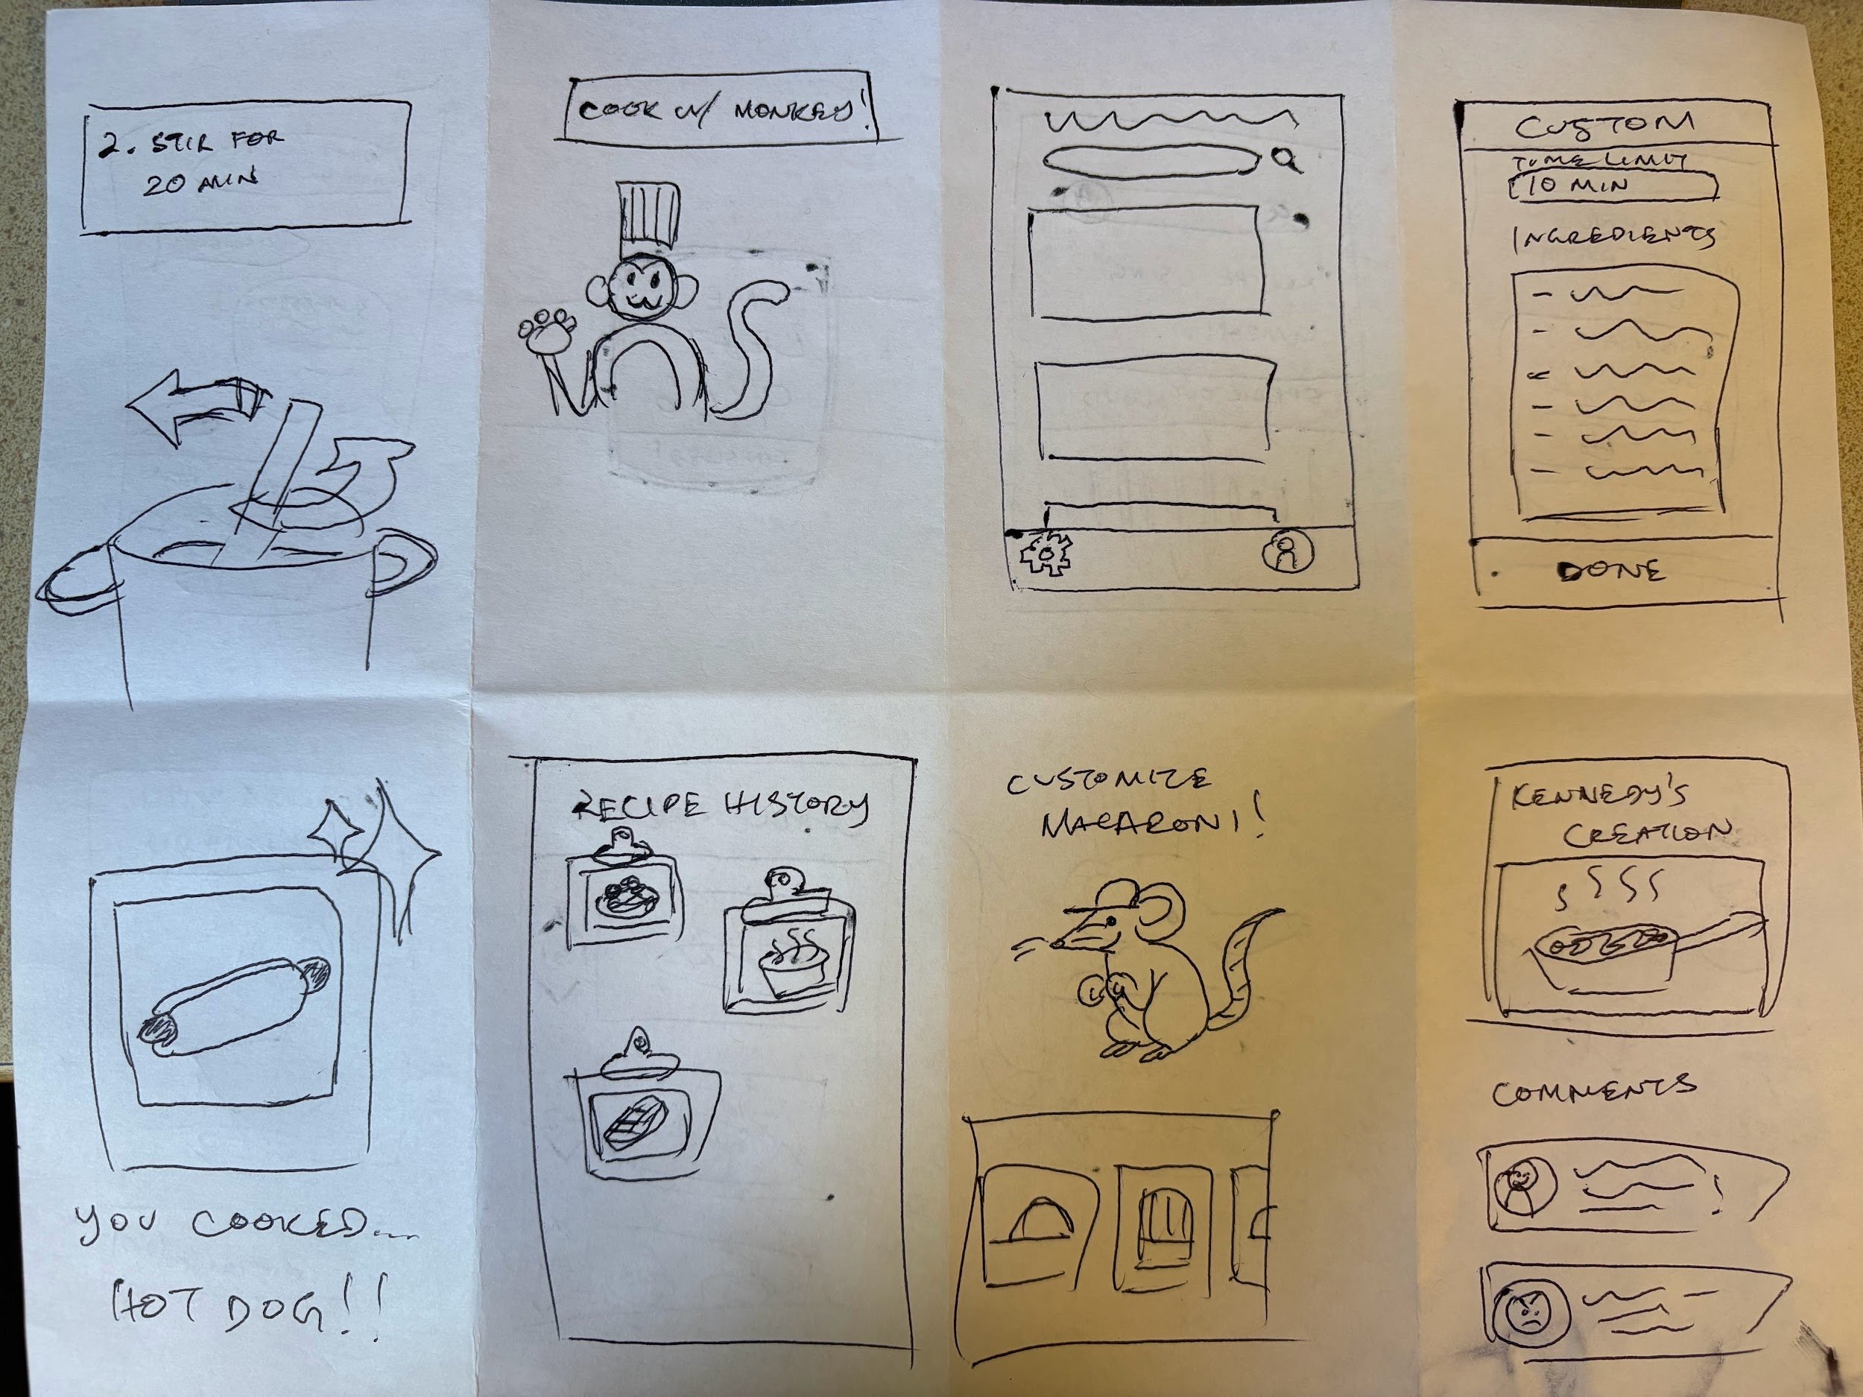
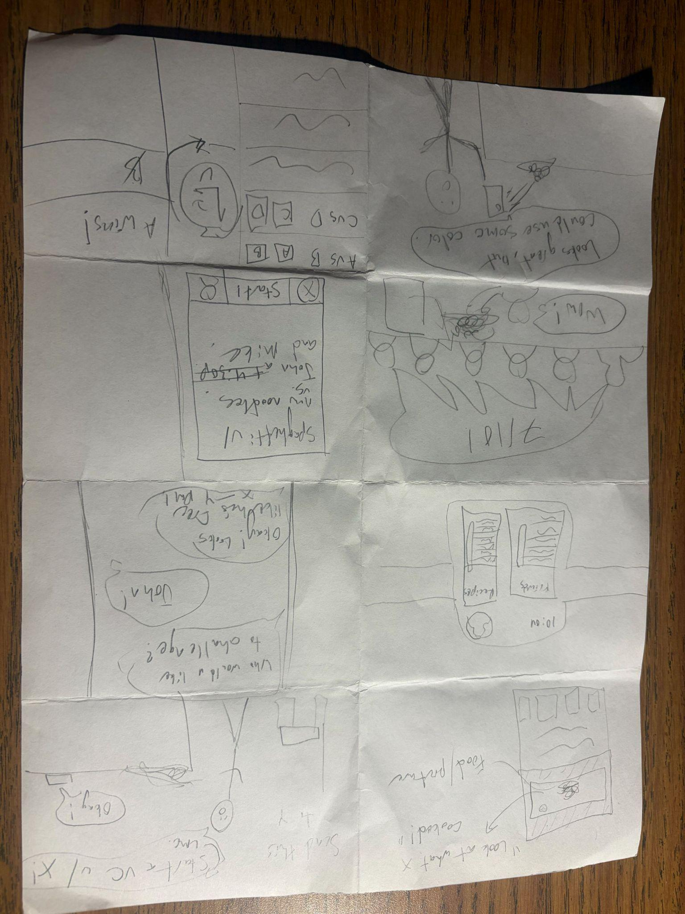
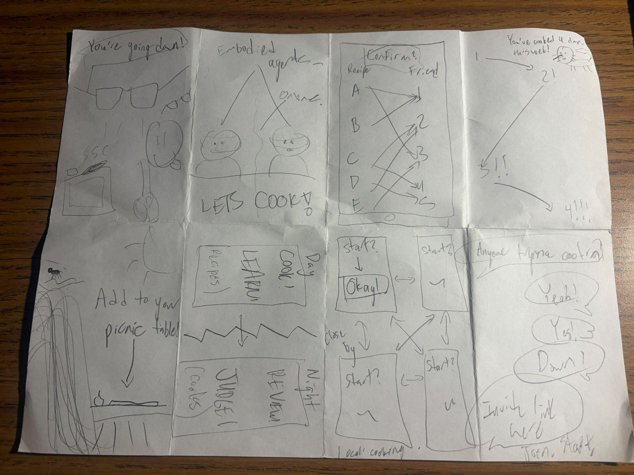
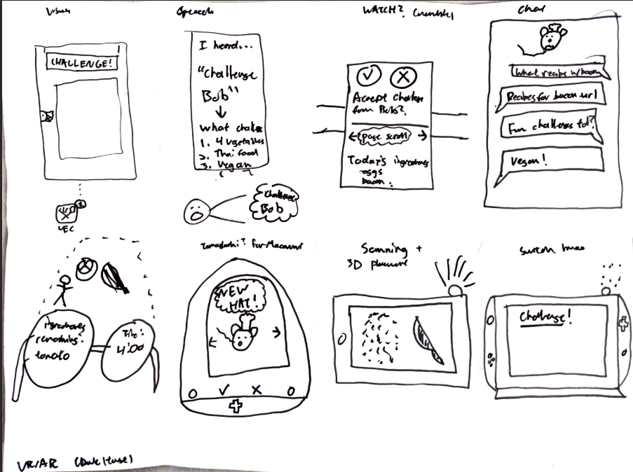
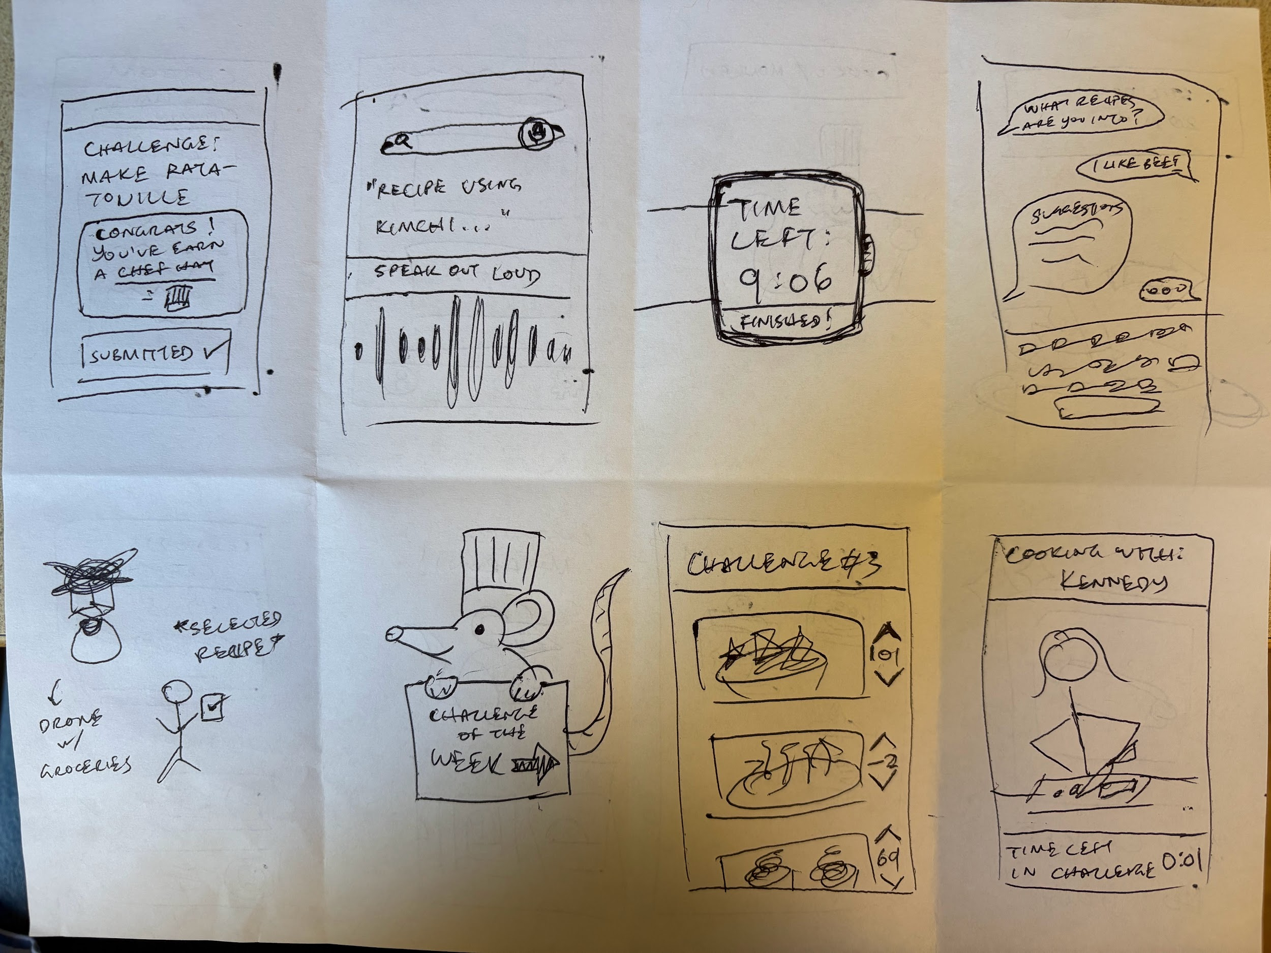
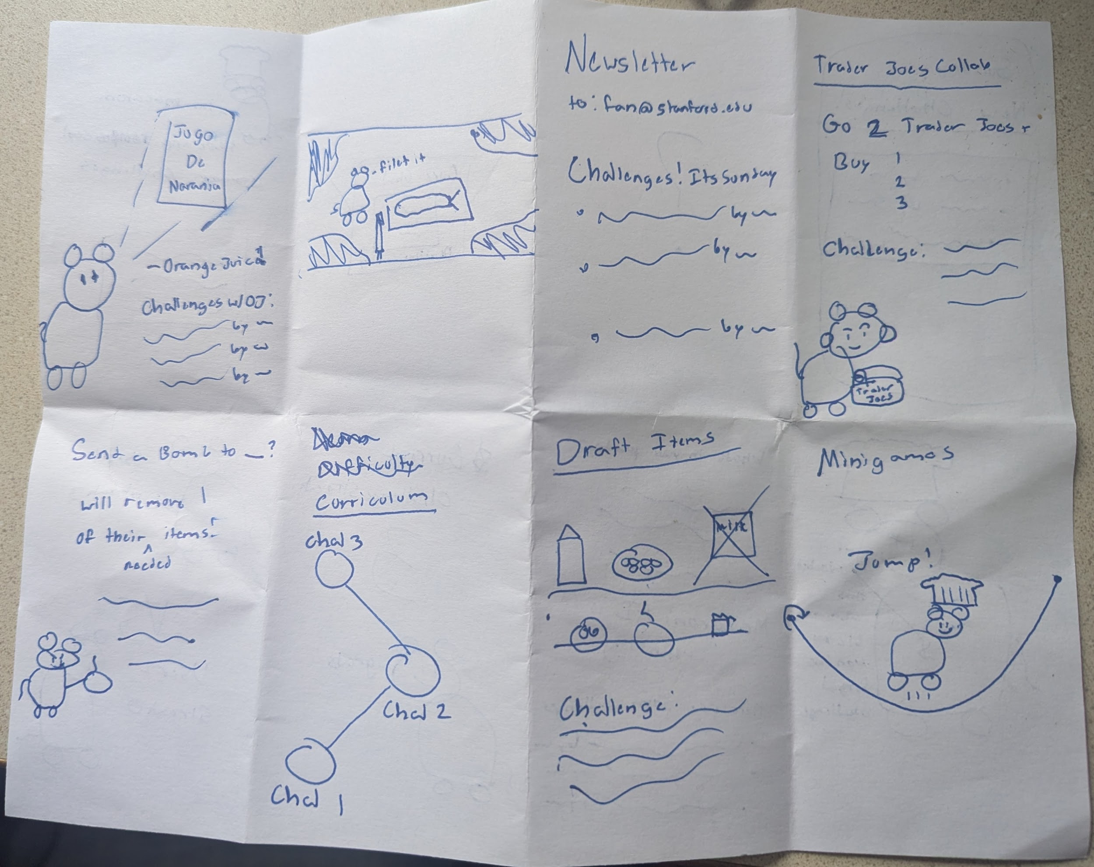
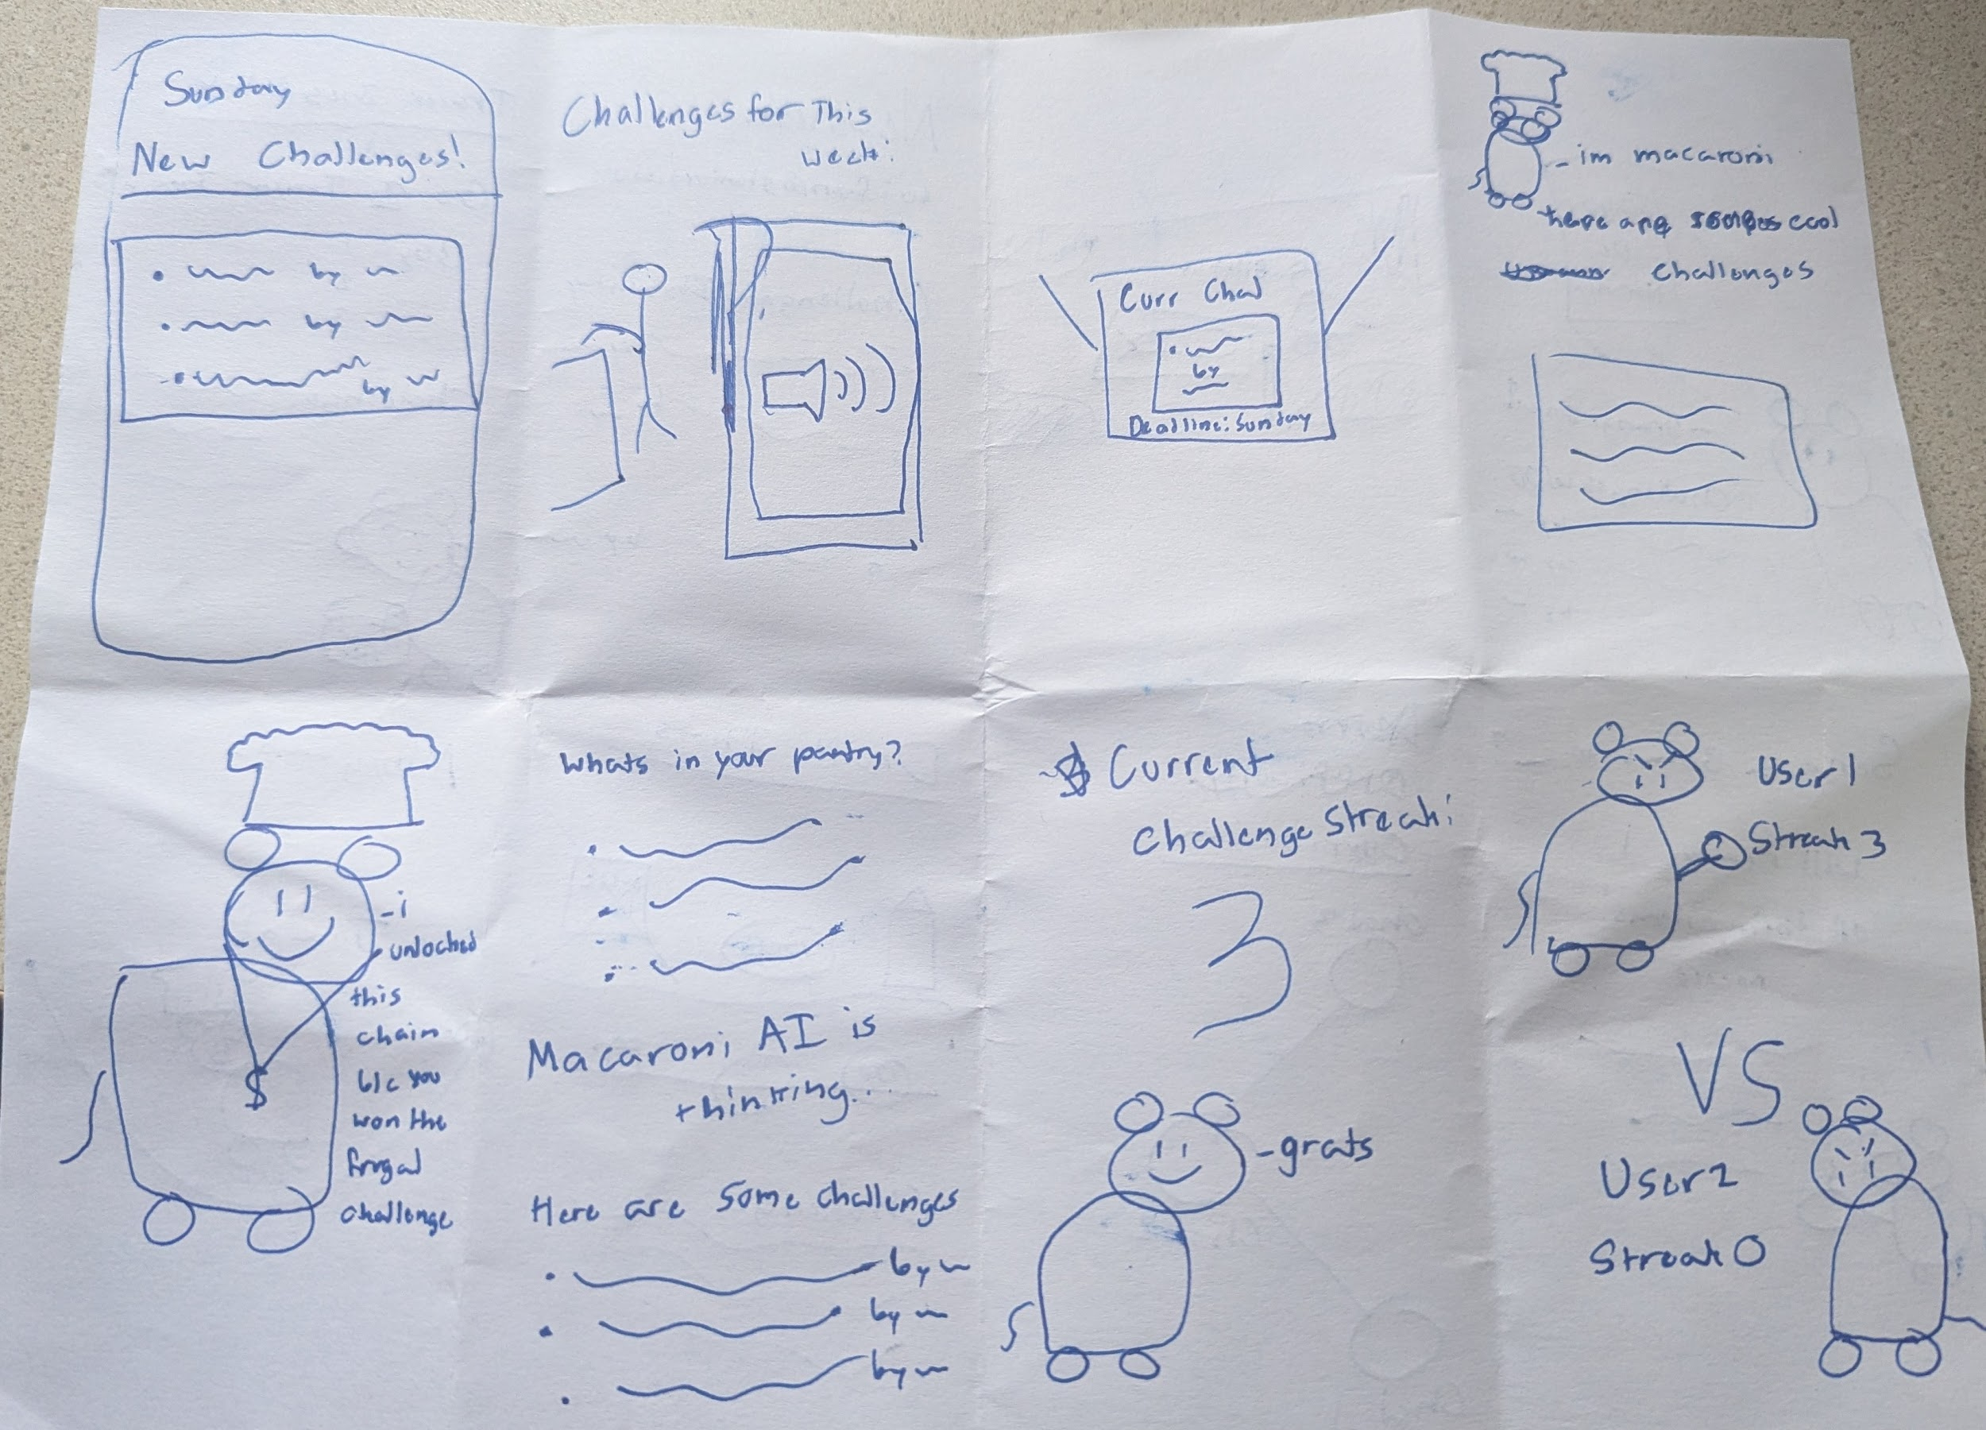
Appendix (cont.) - 20-30 solution idea sketches

Slide 52
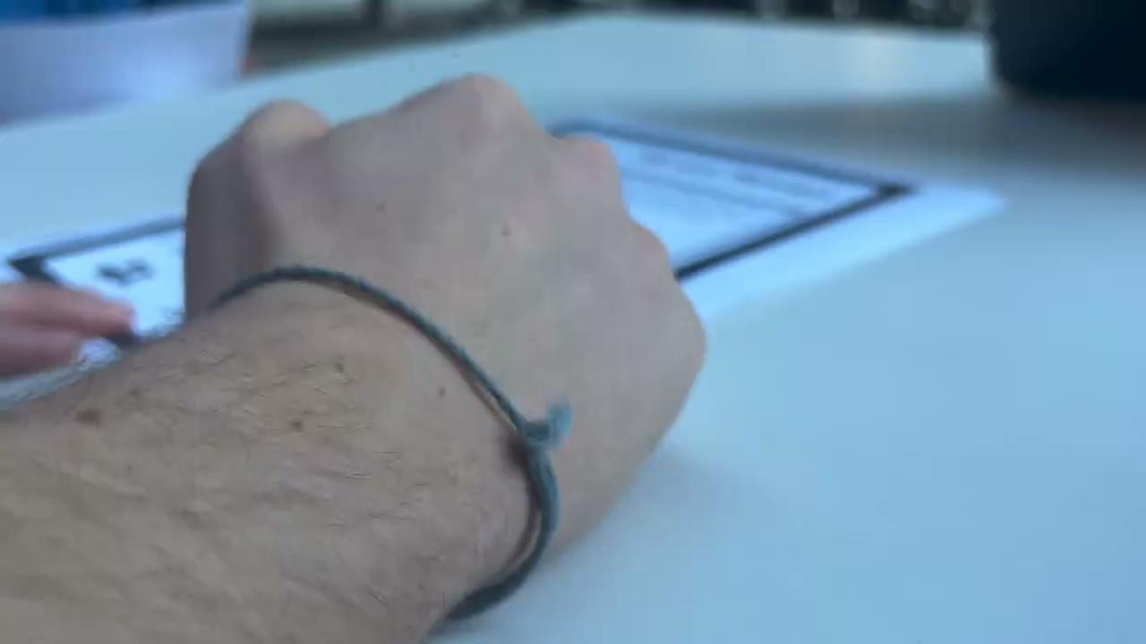
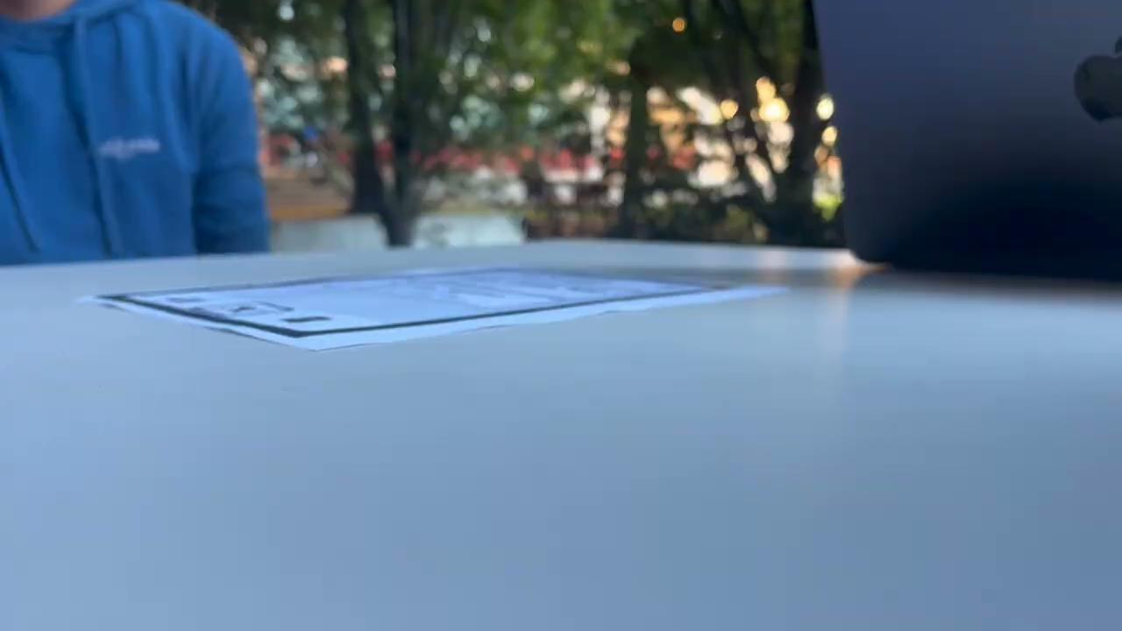
Appendix (cont.) - Video Artifacts
Note: Despite consenting to video, participants requested to not have their face shown. The following participant (Jordan) consented to video/audio, but requested only their hand/arm be physically recorded (and no apparel or face).
Left: Tap into computer placing new screen
Right: Asking about actions and performing a scroll

